Slide 1



Integrating and Exploiting Key Disciplines
Design Thinking, Agile & Business Architecture
Mike Callahan
mike.callahan@agilelayer.com
Midwest Architecture Community Collaboration
November 4, 2021
Copyright © 2021 AgileLayer. All Rights Reserved.

Slide 2
Topics
Ideating and Delivering the Best Future: Opportunities and Challenges
Integrated Playbooks: Combining Design Thinking, Agile & Business Architecture Disciplines
Implementing a Product vs. Project-centric Approach
Design Thinking Workshop Kit
Scaling Agile: Vertical and Horizontal Considerations
Embedding Capabilities and Design Thinking approaches into key Functions & Processes

Slide 3

Ideating the Best Future: Opportunities and Challenges
Being great at Ideating-the-Future advances Opportunity scope & quality
New Markets
New & Improved Products
Better Stakeholder Experiences
Greater Operational Efficiencies
Competitive Advantage
Defensible I.P.
An Innovation Culture
A Collaboration Culture

Slide 4

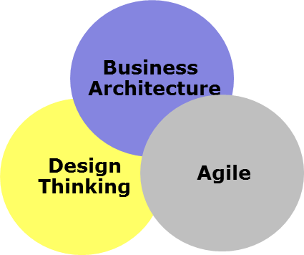
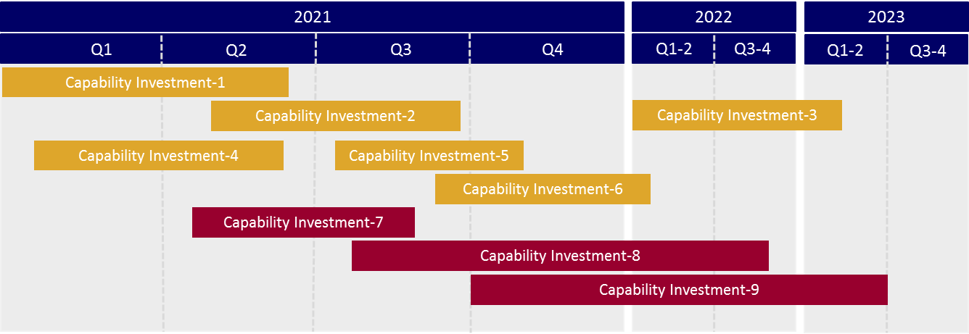
Imperative
Creating a High Impact, Enterprise-scale Ideation-to-Delivery approach
Value-centricity
Transparency
Alignment
Consistency
Efficiency
Flexibility
Time to Market
Best Practices
How can we be better at developing & exploiting high-value Ideas – in an Agile, Enterprise-scale way?
Create opportunity for
Produces
Ideas
Delivery / Execution
Require

Slide 5
Connecting Strategy to Execution
Business SWOT
S2E Objectives:
Best Value for Money
End-to-End Traceability
X-Enterprise Visibility
Alignment
Synergies & Collaboration
Consistency of Approach
Speed & Efficiency
Strategy Formation
Program Conception
Participating Levels of the Organization
Project Conception
Project
Requirements
Project Delivery
Strategy to Execution cycle

Slide 6
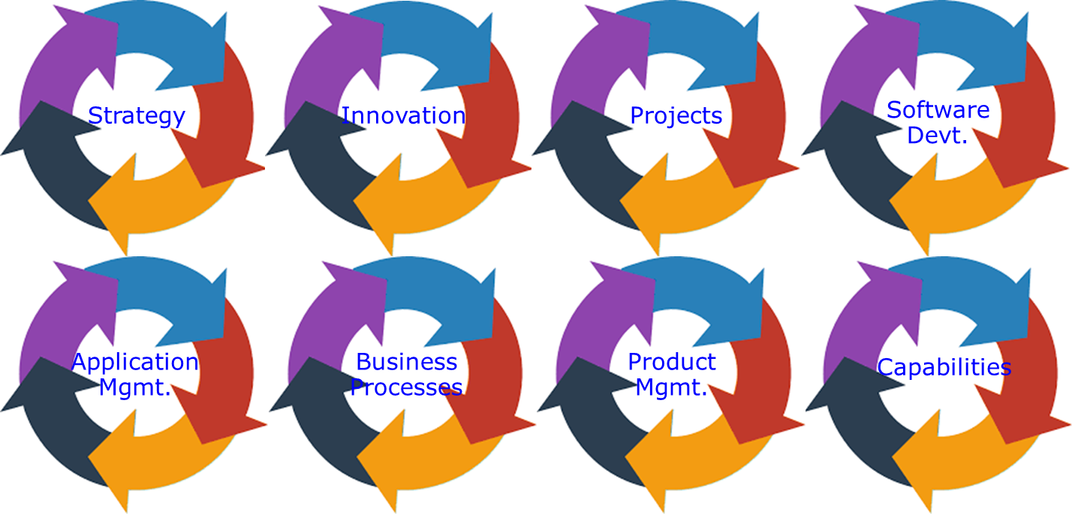
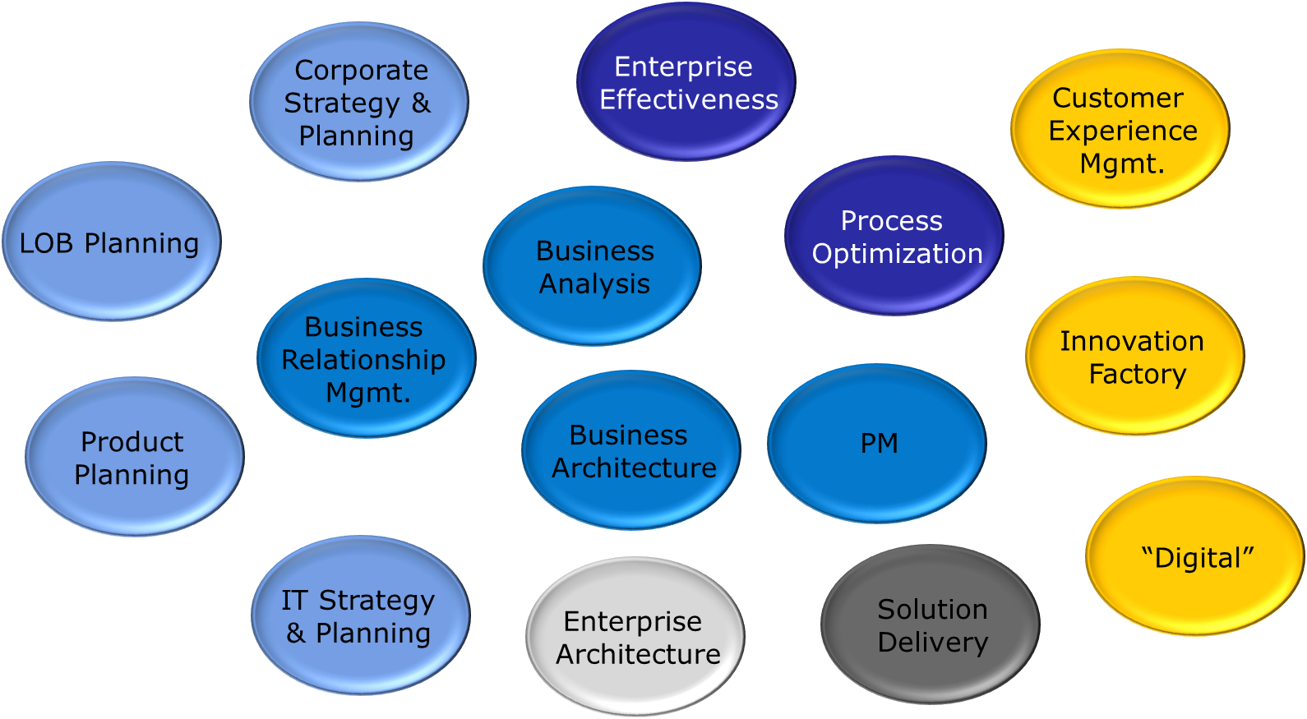
Connecting Strategy to Execution
Challenges
Disparate:
Owners
Purpose
Motivations
Processes
Outputs
Governance
Time Horizons
Tooling
Business SWOT
Strategy Formation
Program Conception
Participating Levels of the Organization
Project Conception
Project
Requirements
Project Delivery
Strategy to Execution cycle

Slide 7
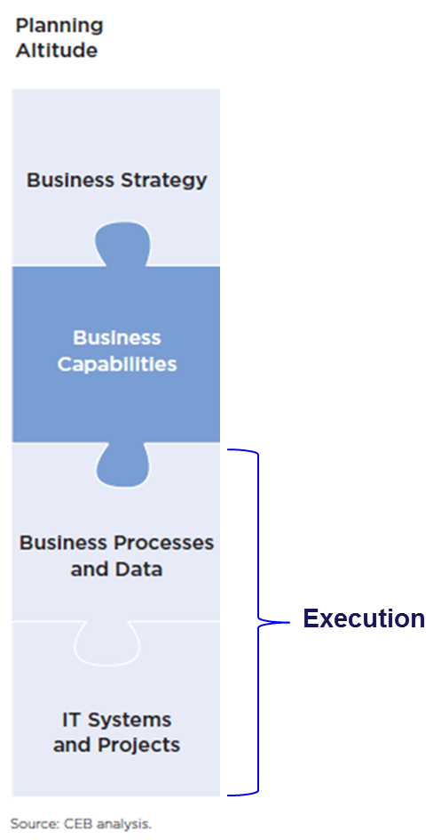
Connecting Strategy to Execution
Provides:
Strategic Focus
Value-centricity
End-to-End Traceability
X-Enterprise Visibility
Business SWOT
Strategy Formation
Are at the right level of abstraction for all Stakeholder types
Are value / purpose-centric
Provide for “bucketing” & abstraction of lower-level implementation elements
“Capabilities” as core planning construct
Program Conception
Participating Levels of the Organization
Project Conception
Project
Requirements
Project Delivery
Strategy to Execution cycle

Slide 8
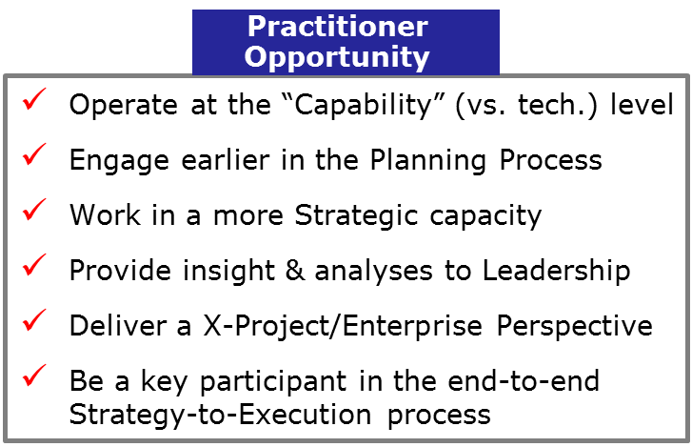
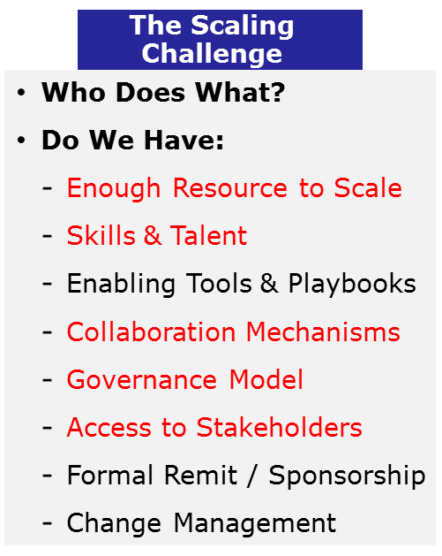
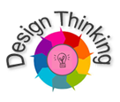

Connecting Strategy to Execution
“Capability” realities, threats and opportunities
Business SWOT
Strategy Formation
“Capabilities” as core planning construct
Program Conception
Capability constraints, levers, and needs
Participating Levels of the Organization
Project Conception
Capability-level requirements, innovations & roadmaps
Project
Requirements
Project Delivery
Capability delivery & life-cycle mgmt.
Strategy to Execution cycle

Slide 9

The Scaling Challenging: Applying Biz Arch across the Planning Cycle
= competent, skilled Business Architect
Business SWOT
Do we have enough competent, skilled and talented Business Architects to fully engage with all business areas and stakeholders, including during the early-stage Strategy, Ideation & Planning activities?
If not, how can we successfully leverage other resources to operate at “full scale” – across the enterprise? What are the enablers, methods and governance mechanisms?
Strategy Formation
Program Conception
Participating Levels of the Organization
Project Conception
Project
Requirements
Resource Scalability?
Real Talent/Skill?
Good Access to Business Leaders?
Project Delivery
Strategy to Execution cycle

Slide 10

The Scaling Challenging: Applying Biz Arch across the Planning Cycle
= competent, skilled Business Architect
Business SWOT
= “Surrogate” Business Architect
(for Business Discovery, Ideation, High-
level Opportunity & Needs Identification)
Strategy Formation
Program Conception
Participating Levels of the Organization
Project Conception
Pragmatic, Practical Scalability
The Right Skills for each Task
Enabling the people who have the best access to Business Leaders
Built-in Connection to the “back-end” Business Architecture work
Promulgation of “Capabilities” approach
Project
Requirements
Project Delivery
Strategy to Execution cycle

Slide 12



The Scaling Challenging: Applying Biz Arch across the Planning Cycle
“Front Office”
“Back Office”
Business Architecture
Business Stakeholder
In-House Strategic
Consultant
Goals
Strategies
Drivers
Risks
Pain Points
Root Causes
Opportunities
Ideas
Needs
Solutions
* Menu of Service Offerings and Delivery Tools & Methods
* Stakeholder “Insights/Answers” Tool & Content
* Discovery Meeting Prep/Questionnaire Tool
* Enablement Kit for Business Stakeholder Workshops
* Capability Ideation Workshop Methodology & Tool
* Stakeholder Engagement Planning Tool
* Management Consulting Skills: Training & Coaching
Consistency
Standard of Excellence
The default “Go-To” Experts
Thought-Leader role
Brand (personal; team)

Slide 13
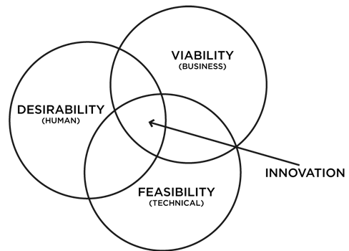
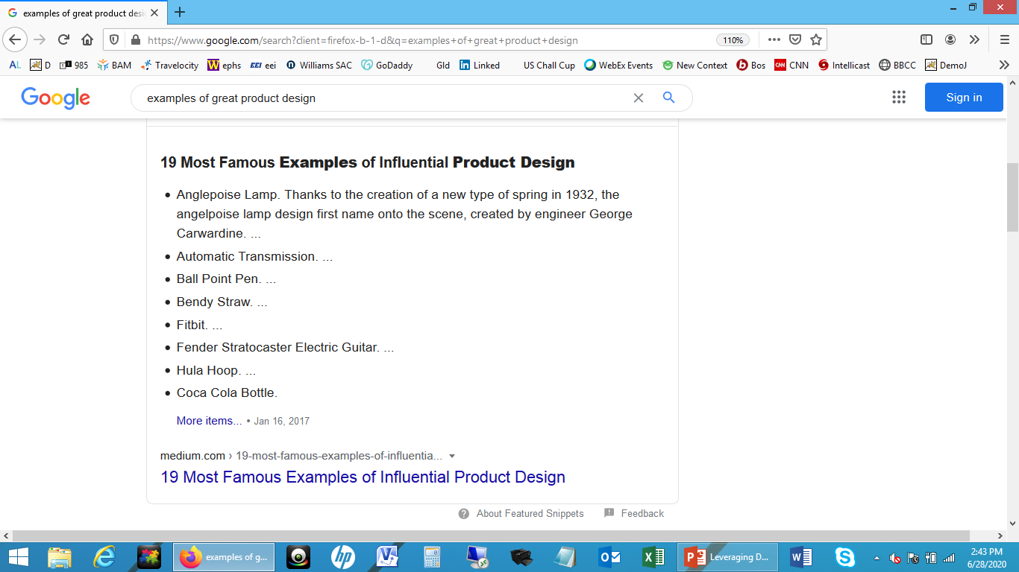
Design Thinking pioneer IDEO: “The sweet spot for innovation can be found at the overlap between desirability, viability, and feasibility.”
Design Thinking: Creating Exceptional Experiences
Awe-inducing. Lasting Memories (e.g., the 1st time you experienced virtual reality).
Empathy: e.g., a customer service agent who truly cares.
Frictionless: Streamlining a normally complex process; e.g. TSA Pre✓®
Red-Carpet Treatment: Being treated so as to feel special & important; e.g. being picked up by a limousine.

Slide 14
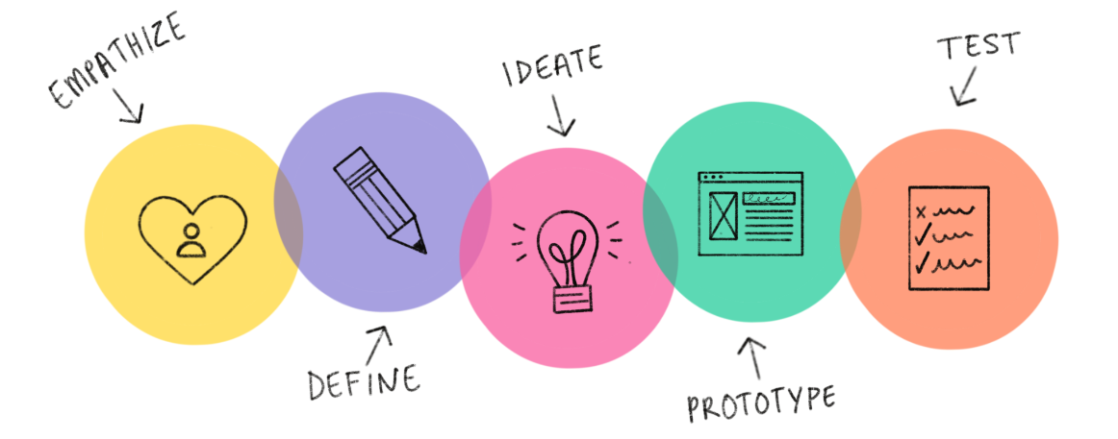
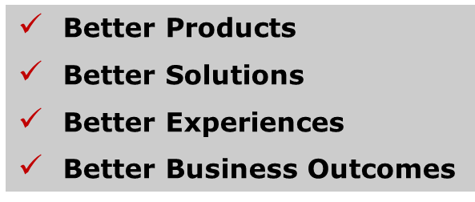
Design Thinking: An Integrative Process & Mindset
Design Thinking and Agile are naturally connected and can be integrated and value-grounded through an underpinning Business Architecture
Design Thinking: 5 Interrelated & Iterative Activities
Fast
Flexible
Iterative
Empathetic
The Agile “Connection”
Business Architecture

Slide 15
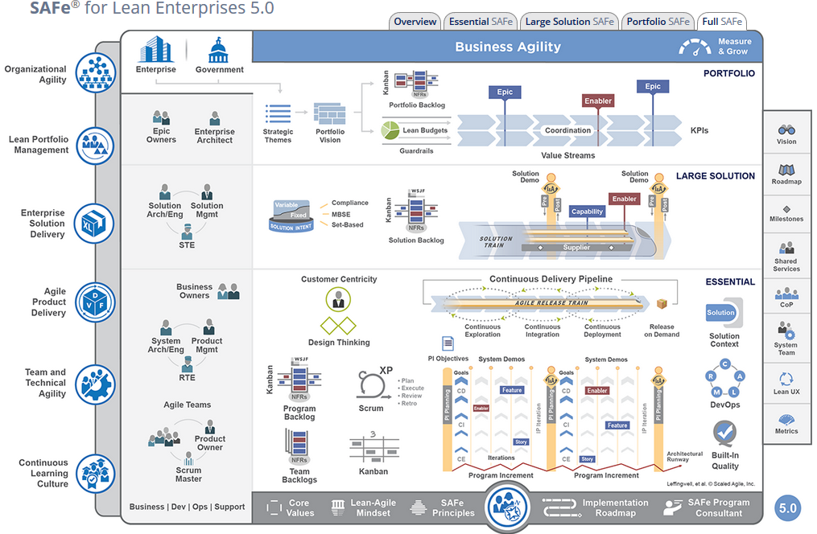
The Scaled Agile Imperative: An Opportunity

Slide 16
Creating a High Impact, Enterprise-scale Ideation-to-Delivery approach
How can we be better at developing & exploiting high-value Ideas – in an Agile, Enterprise-scale way?
Create opportunity for
Produces
Capabilities
Ideas
Ideas (“Ability Statements”)
Features
Delivery / Execution
Require

Slide 17

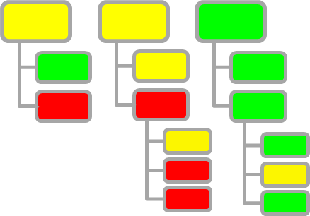
Integrated Approach for Enterprise Digital Transformation
Zero-based Design (ZBD) generates “Ability Statements”
“Ability Statements” map to Capability Requirements
ZBD
Design Thinking
ZBD
Design Thinking
ZBD
Strategic Planning
Performance Improvement
CX
“Ability Statements”
“Ability Statements”
Capability Portfolio & Roadmap
ZBD
“Ability Statements”
ZBD
“Ability Statements”
ZBD
Product Mgmt.
Digital Transf.
BSA / Agile
Design Thinking
Design Thinking
i.e., “We need the ABILITY to send event-driven Service alerts to mobile members.”

Slide 18
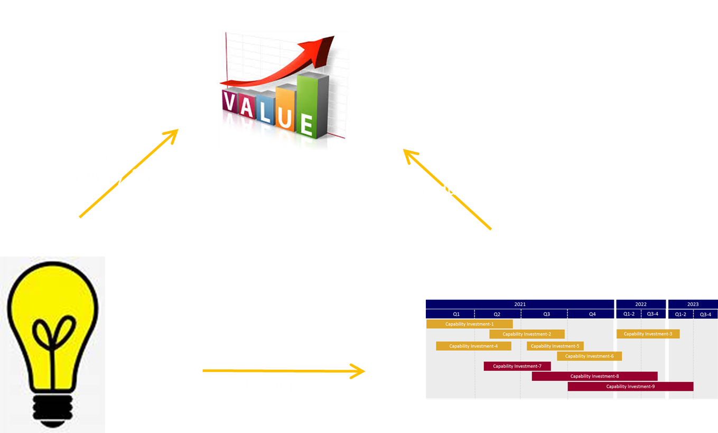
Ideating the Best Future: Opportunities and Challenges
Ideating-the-Future brings
with it a number of Challenges:
Project mentality
Time pressures
Coordination & Alignment
Rigid mind-sets and habits
Tying Ideas to Value
Tying Ideas to Business Architecture
Building a workable, federated operating model and culture

Slide 19
Challenge: Alignment, Traceability and Value Assurance
Goal & Strategy Development
Investment Management
Project Delivery Management
Common S2E Issues:
Disconnected processes and governance models
A multiplicity of planning & management “languages”
Disparate, Conflicting Stakeholder Interests
Vague / Opaque connection of Strategic Intent to Project-level Requirements
Lack of Trace-ability back to Business Value during project delivery and post-project operational mode
Attractiveness of the Silo-ed Approach to some Senior Leadership
Technology Portfolio Management

Slide 20
Approach: Alignment, Traceability and Value Assurance
Which of our posited Strategies can be realistically executed given our current and possible Capability Portfolio?
What key Competitor Capabilities can we “leap frog” in order to create sustainable competitive advantage?
How can our Partner Eco-system Capabilities enable our Strategies of Choice?
Which Capability Investments will best support our Strategies?
Where can we leverage Capability Investments across various business domains and initiatives?
Where can we best utilize Partner Capabilities to drive efficiencies and time to market?
Goal & Strategy Development
Investment Management
Project Delivery Management
Capabilities-based Planning
Technology Portfolio Management
What are the Epics and Features that will elaborate the posited Capability-level Needs / Investments?
Are we aligning all Project Iterations with the stated Capability/Value Roadmap?
Are we using the Business Architecture to find the x-Project, x-Initiative dependencies and synergies?
How does our target-state Business Operating Model (aka Business Architecture) align to our Enterprise (IT) Architecture? What are the Dependencies and Risks?
Where can we leverage Digital/Technical Capability Investments across various business domains & initiatives?
Where can we best utilize Partner Capabilities to advance our strategic technology/architecture vision?

Slide 21
Integrated Design & Planning Framework
Value-centricity
Transparency
Alignment
Consistency
Efficiency
Flexibility
Time to Market
Best Practices
Strategy
Programs
Componentization
Componentization
Capabilities
Agile Execution / Delivery
Operation
APIs & Services
Products
Products
CX
CX
Design Thinking
Value Targeting
Value Leak Detection
Value Assurance Analysis
Value Course Correction
Value Assurance Framework
Business Outcomes / Goals Management

Slide 22
Framework Value
Integrated Design & Planning Framework
Integrated, End-to-End Approach
Full Traceability (Ideas → Models → Technical Design)
Consistent, Repeatable, Best Practices-based Approach
Value-centric
Easy to Operate, Workshop-based program
Light Touch, High-Impact delivery techniques
Fosters Alignment across LOBs, projects and disciplines
Key Outputs
Design Thinking
KEY OUTPUTS:
North Stars
Ability Statements (Ideas/Needs)
Value/Feasibility Assessments
Mapping to Capabilities
Domain Modeling
KEY OUTPUTS:
Business Domains List
Domain Descriptions
Domain Models
Event Model (optional)
Produces Best Possible Ideas
Ensures Great Design
Agile Delivery
Capability Modeling
Stipulates Need and ensures Value Realization
Service Modeling
KEY OUTPUTS:
Value Maps
Capability Model
Capability Assessments
Business Architecture Model
Capability Requirements & Roadmaps
KEY OUTPUTS:
Service Candidates & Blueprints
Service Definitions
Mappings to Biz Architecture
Service Roadmaps

Slide 23
Integrated Design & Planning Framework
3 Workshop-based Playbooks
Design Thinking
Domain Modeling
Zero-based Ideation & Design
Integrated Service Design
Capability Modeling
Capabilities-based Planning / Business Architecture
Service Modeling

Slide 24
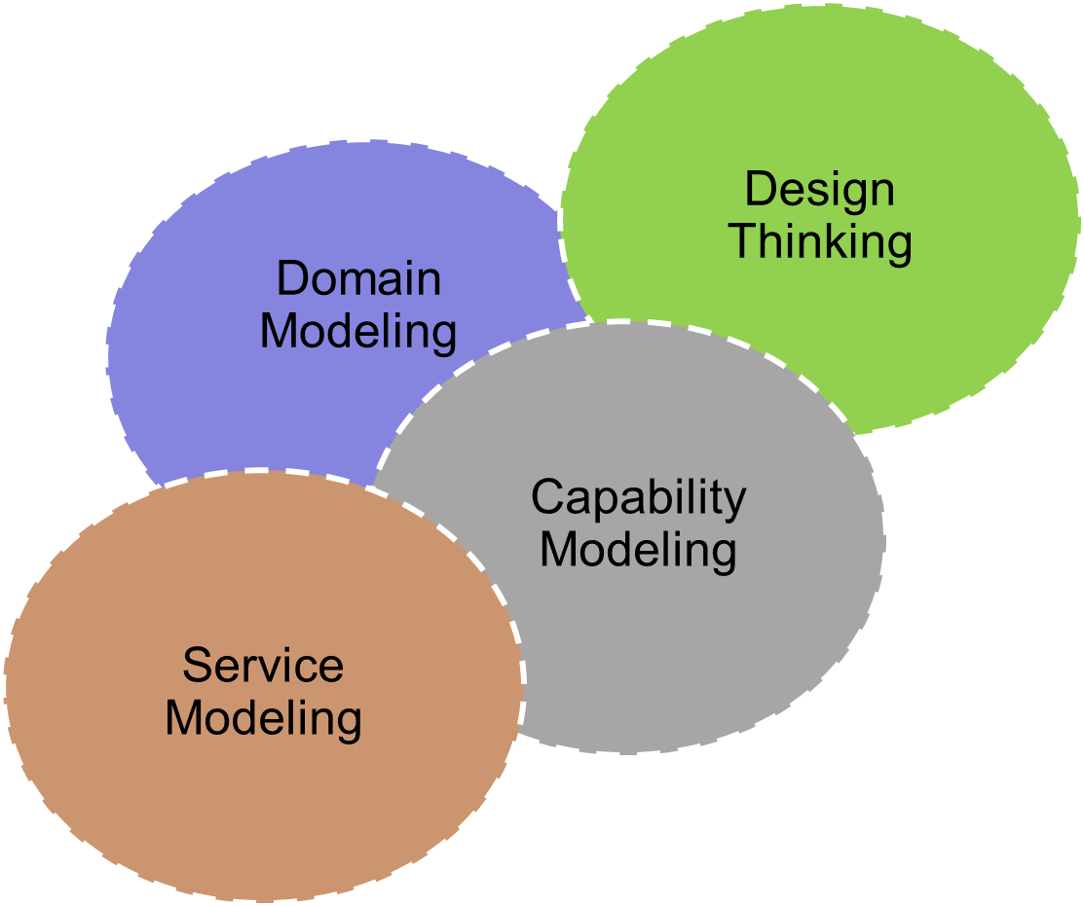
Integrated Design & Planning Framework
Framework Enablement Kit
Methodology
Best Practices
Reference Models
Workshop Material & Facilitation Tools
Stakeholder Deliverables Templates
Life-cycle Alignment & Integration
Governance Model
Education & Change Management
“Ability Statements”
Method / Playbook | Audience | Inputs | Outputs
Design Thinking | Strategy Owners Product Owners CX Owners Business Architects Etc. | Business, Product & CX Strategies, Opportunities & Needs External / Industry Perspective | North Stars Ability Statements (Ideas/Needs) Value/Feasibility Assessments Mapping to Capabilities
Domain Modeling | Business Domains SMEs Business Architects Information Architects Enterprise Architects | Ability Statements (Ideas/Needs) Capability Descriptions Business Function Descriptions Enterprise Info. Architecture | Business Domains List Domain Descriptions Domain Models Bounded Contexts Ubiquitous Language
Capability Modeling | Strategy Owners Product Owners CX Owners Business Domain SMEs Business Architects | Existing Capability Model Business Function Descriptions External / Industry Perspective Etc. | Value Maps Capability Model Capability Assessments Business Architecture Model Capability Roadmaps
Service Modeling | Product Owners Business Architects Service Architects Information Architects | Business Requirements Capability Model Domain Model Enterprise Info. Architecture Service Catalog / Blueprint | Service Candidates & Blueprints Service Definitions Mappings to Biz Architecture Service Roadmaps

Slide 25
Integrated Design & Planning Framework
3 Workshop-based Playbooks
Design Thinking
Domain Modeling
Zero-based Ideation & Design
Integrated Service Design
Capability Modeling
Capabilities-based Planning / Business Architecture
Service Modeling

Slide 26
Good Design drives Componentization & Exploitation of Agile-DevOps
Identify & Design the Right Things, the Right Way
Agile
Containers / DevOps
Integrated Service
Design
Iterative Parallel Delivery
Working Solutions
Business Domain
(Cloud-native & On-Prem)
Sub-Domain
Service
Service Candidate
Service Candidate
Service Candidate
Service Candidate
Service Candidate
Service Candidate
Service
Service
Service
Capability
Capability
Capability
Service
Service
Service
Service Candidate
Service
Service
Service Candidate
Service
Capability
Capability
Capability
Service
Service
Componentization
Standardized Interfaces
Modularity / Flexibility
Smart Re-use
Business Alignment
Technical Alignment
Scale-ability
Life-cycle Automation
Service Candidate
Service Candidate
Service Candidate
Service
Service
Service
Service
Sub-Domain
Service
Service
Capability
Capability
Capability
Service
Service Candidate
Service Candidate
Service Candidate
Service Candidate
Service
Service
Service
Service
Service
Capability
Capability
Capability
Service
Service Candidate
Service Candidate
Service Candidate
Service Candidate
Service
Service
Service
Service
Service
Service

Slide 27
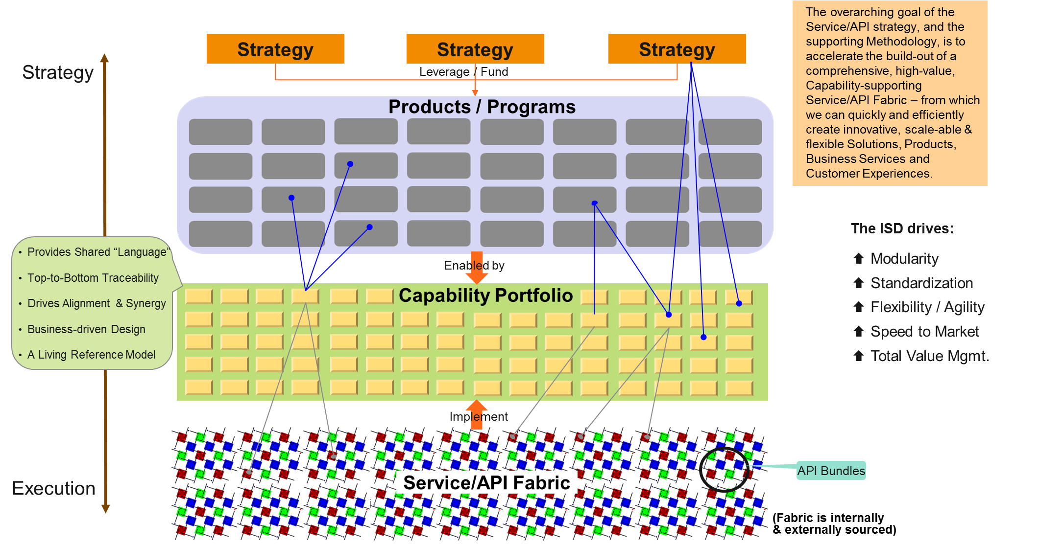
Designing and Leveraging the Service/API Fabric

Slide 28
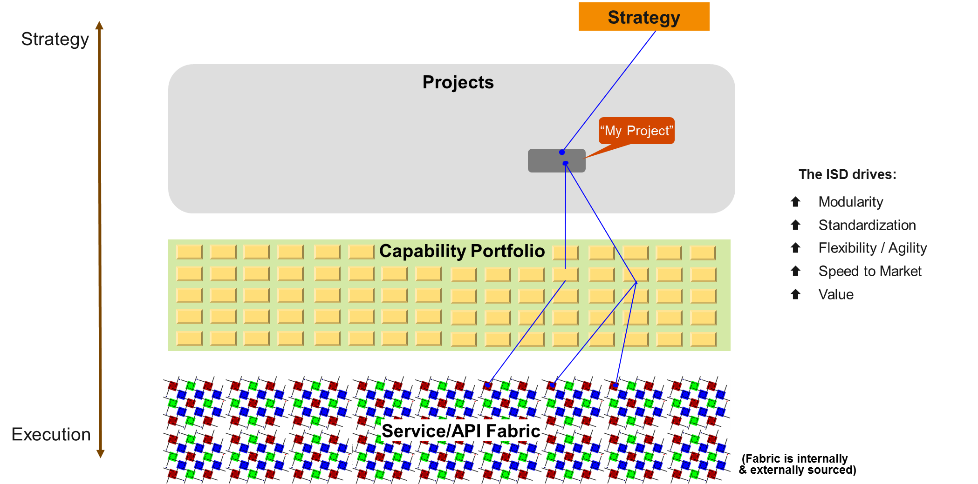
Designing and Leveraging the Service/API Fabric

Slide 29
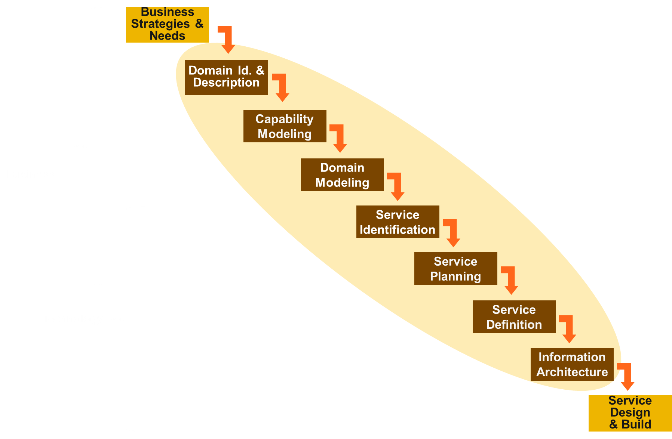
Designing and Leveraging the Service/API Fabric
Business-driven Approach
Provides Lingua Franca (“Capabilities”)
Systematic and Standardized
Iterative
X-Program/Project “aware”
Build-out of the “Service/API Fabric”
Drives exploitation of The Cloud
Drives use of Event-driven Arch.
Services treated as 1st class assets
ISD¹
¹ “Integrated Service Design”

Slide 30
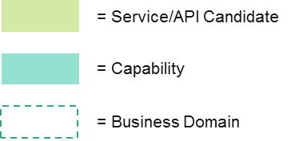
Service Candidates–Capabilities–Domains Map
Employee/Member Management
Medical Underwriting
Employee Onboarding Capability
Hire Employee
Evidence of Insurance Intake Capability
Solicit EOI
Register Employee
Submit EOI Information
Member Enrollment Capability
Submit EOI Certification
Enroll Employee
Certify EOI Request
Employee Mgmt. Capability
Validate EOI
Search Employee
Request Employee Information
EOI Maintenance Capability
Retrieve Employee Information
Update EOI Decision
Benefits Mgmt. Capability
Check Eligibility
EOI Reporting Capability
Generate EOI Report
Elect Member Benefits
Retrieve Benefit Info.
Update Member Benefits
Employer Management
Update Dependents
Employer Mgmt. Capability
Terminate Member Benefits
Retrieve Employer Plan Details
= Uses
Employee
Maintenance
Capability
Update Employee Information
Process Life Event
Enterprise Services
Update Compensation
Implementation Mgmt. Capability
Employee Termination Capability
Retrieve Employer API Details
Terminate Employee

Slide 31
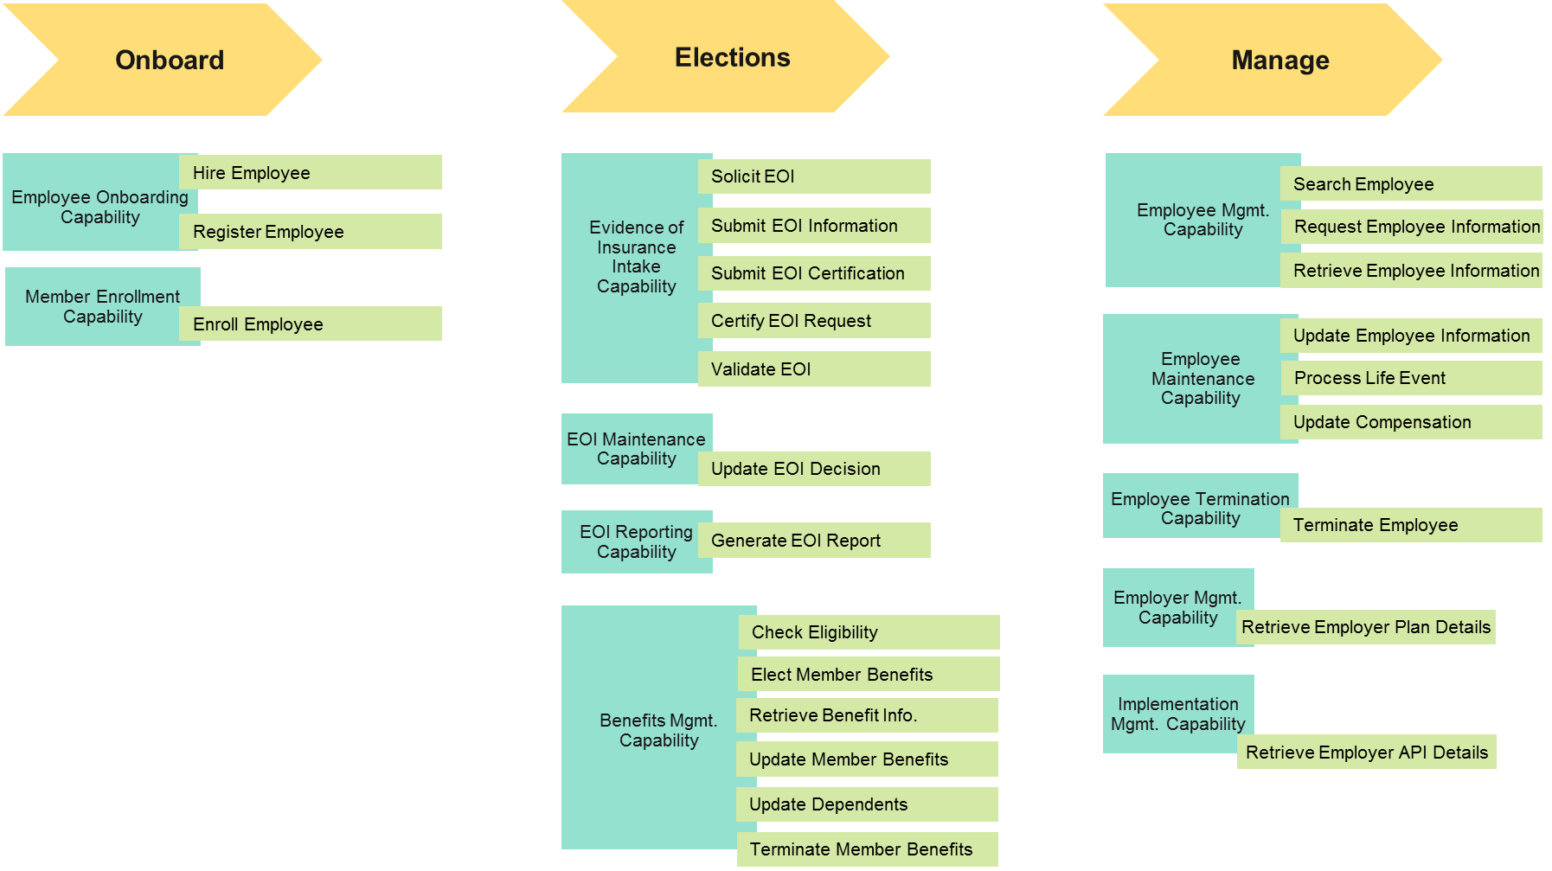
Service Candidates–Capabilities–Journey View

Slide 32
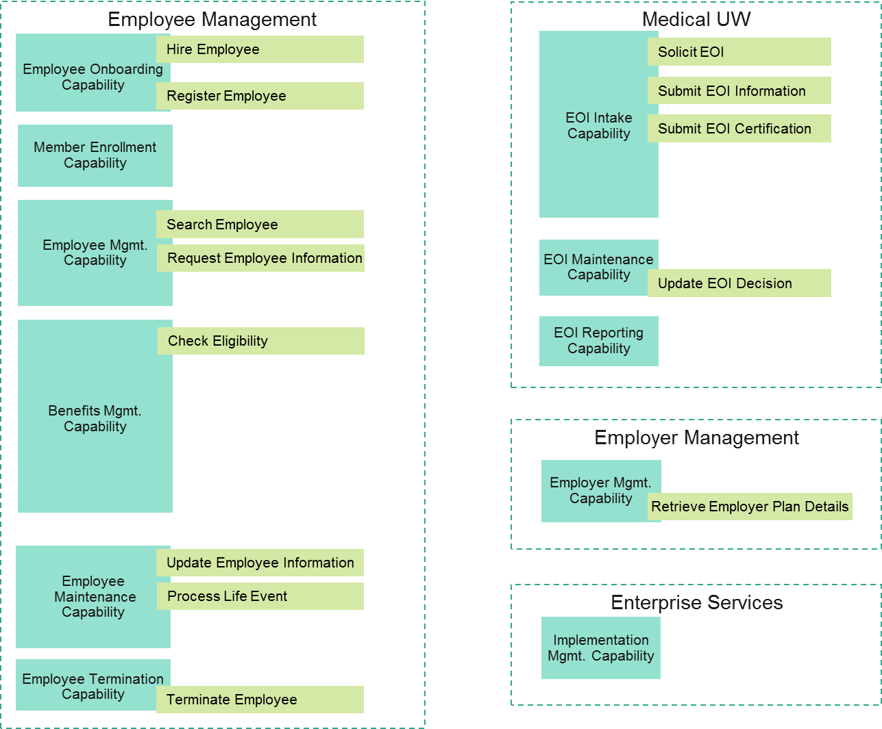
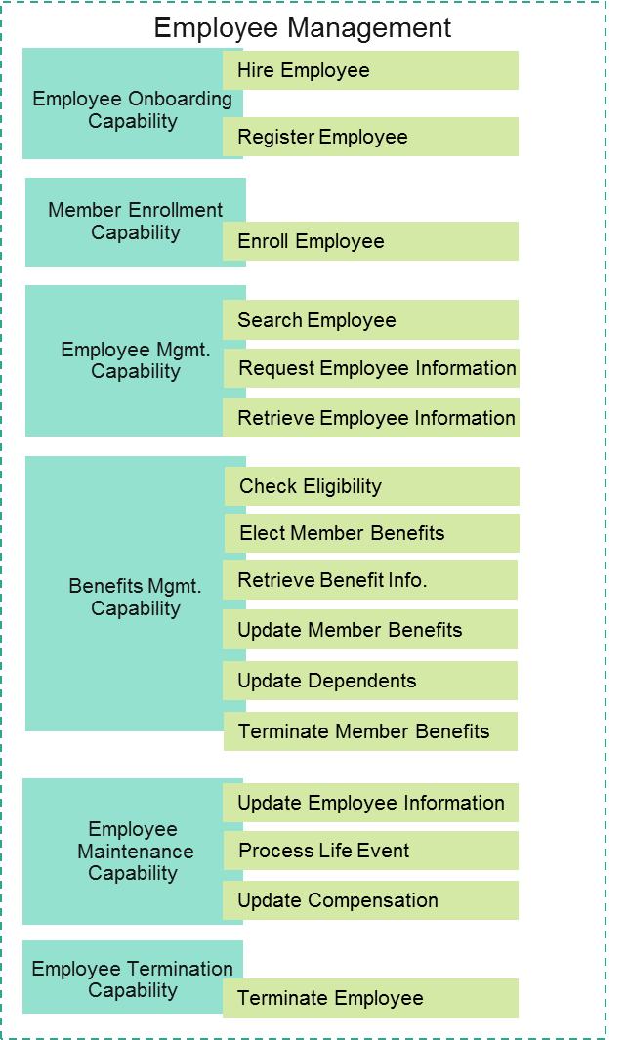

Modeling & Planning the Digital Future-State
Current-State
Future-State
✓
✓
✓
✓
✓
✓
✓
✓
✓
✓
✓
✓

Slide 33
Integrated Design & Planning Framework
Design Thinking
Domain Modeling
Produces Best Possible Ideas
Ensures Great Design
Agile Delivery
Capability Modeling
Stipulates Need and ensures Value Realization
Service Modeling
KEY OUTPUTS:
Value Maps
Capability Model
Capability Assessments
Business Architecture Model
Capability Requirements & Roadmaps

Slide 34
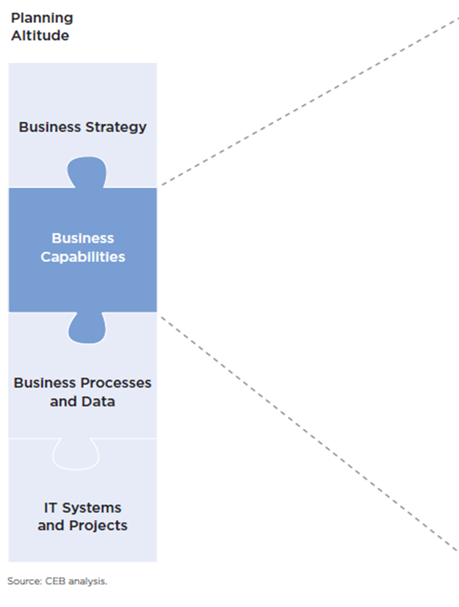
“Capabilities” primary role: Connecting Strategy to Execution
Are at the right level of abstraction for all Stakeholder types
Are value / purpose-centric
Provide for the “bucketing” and abstraction of lower-level implementation elements
Capabilities as “Products”
Ownership
Assessments
SLAs
Life-cycle Management
Governance
Architectural Alignment
Execution

Slide 35


Capabilities-based Modeling
Value Streams
Value
Efficiency
CX
Competitive Advantage
Defensible I.P.
Capability Portfolio
Core Capabilities
Digital /
Technical
Capabilities
Strategic Planning
Product Planning & Design
Supporting Capabilities
Partner Eco-System
Customer Journeys

Slide 36
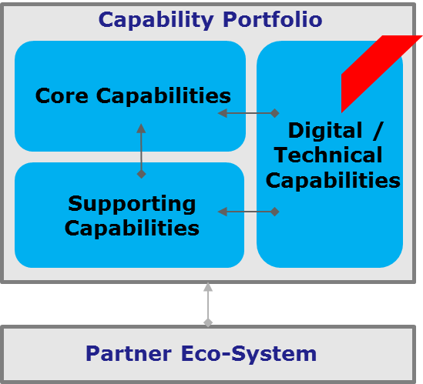
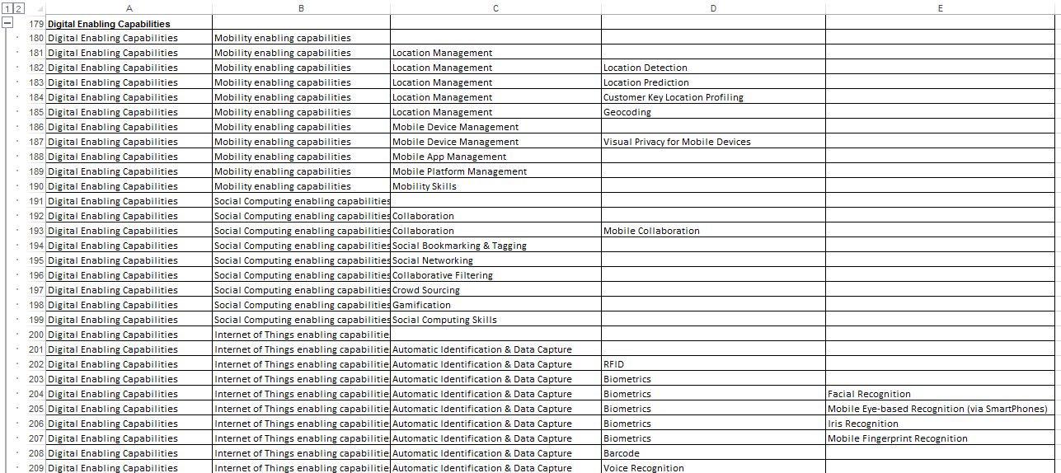
Capability Modeling: Digital Enabling Capabilities
The Approach:
Develop the a Digital Capability Blueprint & Roadmap
Ideate the Digital Future State via Design Thinking connected to Capabilities-based modeling
Map Digital Capabilities to Business and Technology Architectures
Provide rapid, meaningful Impact & Value Assessments
Drive a X-Enterprise Perspective & Vision

Slide 37
Customer Journey: Capability Target-State, with Features
Awareness of the new Service
Understanding
Choices & Making
Selection
Getting Started with the Service
Using the Service
^{Choice Availability}
^{Choice Selection}
^{Service Provisioning}
Customer Notification & Service Blocking
^{Required Capabilities}
Increment
Feature
^{Multi-Channel} ^{Choice Presentation}
^{Contract} ^{Signing}
^{Welcome}
Historical Usage Tracking & Pres.
^{Choice Comparison}
^{[new Capability]}
Increment
Feature
Multiple Account Self Management
Increment
Feature
Feature
Feature
^{Multi-Channel Support}
Feature
Increment
Feature
Feature
^{L}
^{Location Prediction}
^{Mobile Dashboarding}
^{Digital Enabling Capabilities}
Increment
Feature
Feature
^{[new Capability]}
Feature
Feature
Feature
Feature

Slide 38
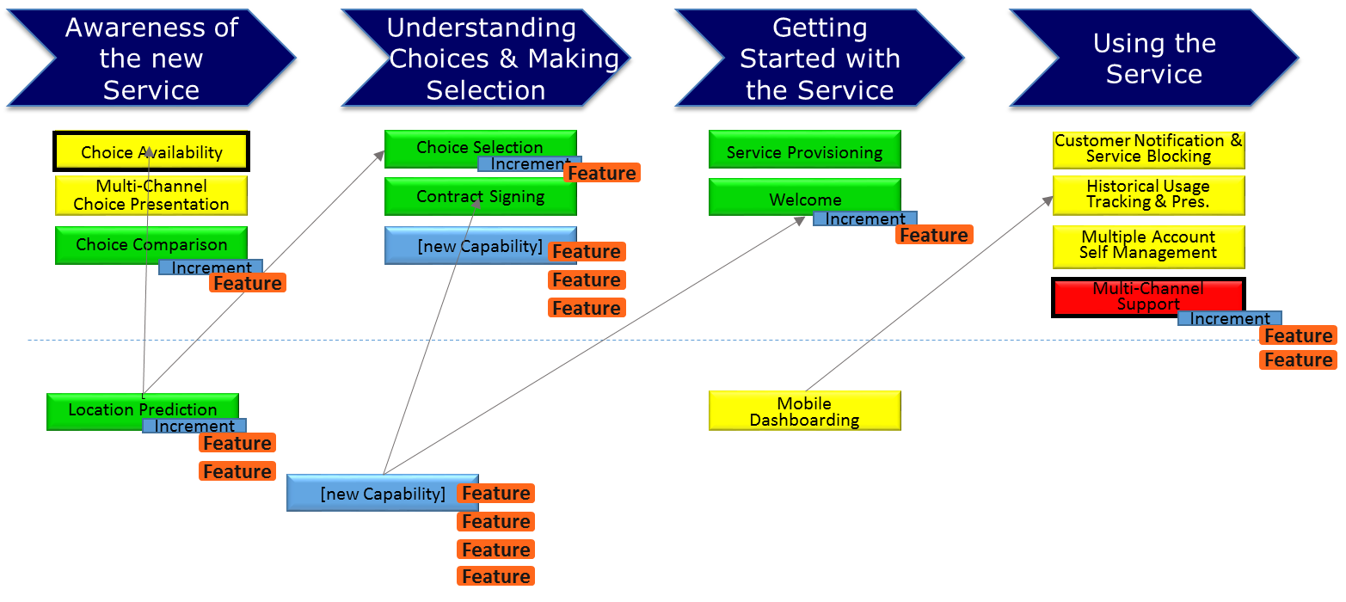
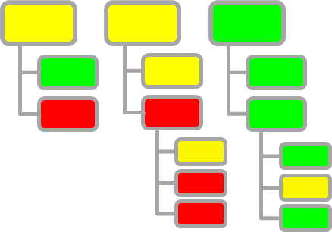
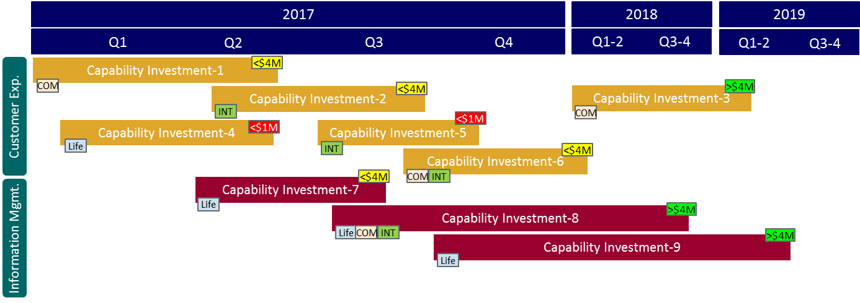
The BIG WIN: Enterprise Alignment: Using the Capabilities-based Planning approach
Synergies
Opportunities
Alignment
Visibility
Dependencies
Risks
ROI / TCO
Enterprise Capability Model
Enterprise Capability Roadmap

Slide 39

Delivering Executive Insights: via an Enterprise BA Model
“Business Architecture Views”
(Mode 1)
Technology
Analysis Dimensions:
Goals
Strategies
Capabilities
Products
Regions
Organizations
Technology
Business Lines
Programs
Projects
Value Streams
Customer Journeys
Business Processes
Etc.
Regions
Executive Insights (via
BA-fueled “Transversal Views”)
The Business Architecture
Strategies
Capability Assessment:
Value Contribution
Business Differentiation
Strategy Support
Maturity Level
Business Risk
Technology Risk
Operating Cost
Level of Reuse/Sharing
Ease of Outsourcing
Etc.
Enterprise Capability Portfolio

Slide 40
CX-centric Meta Model [example]
Produces / Impacts
Strategy
Means to Achieve
Business Outcome
Business Service
Measures
Drives
KPI / Measure
Product
Supports execution of
Contributes to
Impacts
Plan
Delivers on / Enables
Project
Has
Customer Experience
Program
Interactions
Produces
Improved by
Capability Increment
Funds & Delivers improvement in
Has
Customer Journey
Enables
Capability
Enables
Feature
Occurs in 1 or more
Physically realized by one or more
Executable Code
Process
Operational
Value
Stream
Capability
Instantiation
People
Technology
Composed of
Information
Services
/ APIs
A “Planning Concepts Model” (aka Meta Model) structures & frames the Business and IT planning and design activities
Solution

Slide 41
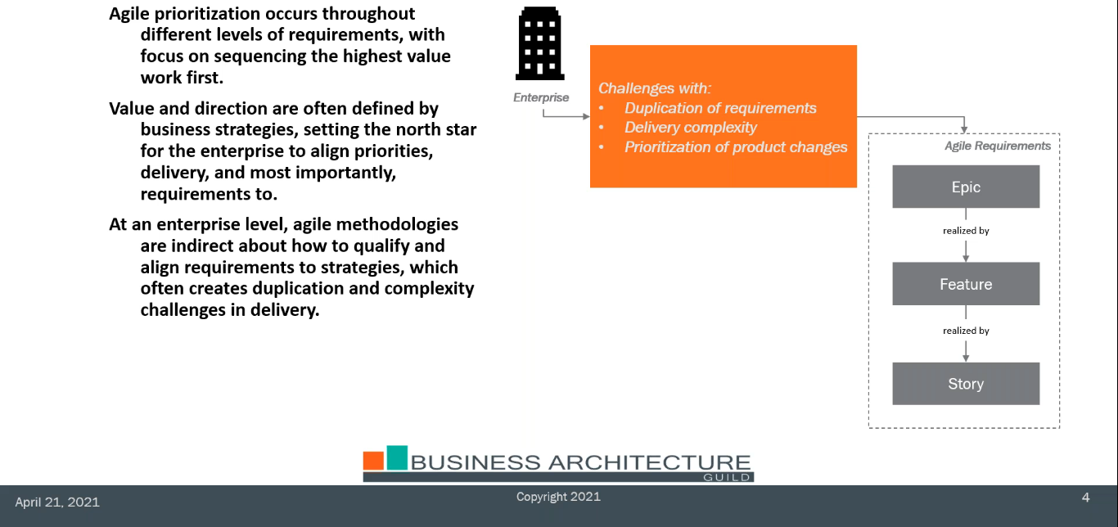
Challenge: Front-end Planning Constructs

Slide 42
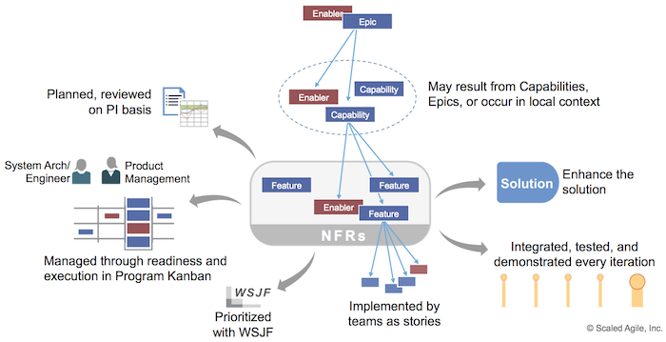
“Features and Capabilities are central to the SAFe Requirements Model. They are critical to defining, planning, and implementing Solution value.”
“A Feature is a service that fulfills a stakeholder need. Each feature includes a benefit hypothesis and acceptance criteria, and is sized or split as necessary to be delivered by a single Agile Release Train (ART) in a Program Increment (PI). A Capability is a higher-level solution behavior that typically spans multiple ARTs. Capabilities are sized and split into multiple features to facilitate their implementation in a single PI. Features also lend themselves to the Lean UX process model, which includes a definition of the Minimum Marketable Feature (MMF), a benefit hypothesis, and acceptance criteria. The MMF helps limit the scope and investment, enhances agility, and provides fast feedback. Capabilities behave the same way as features. However, they are at a higher level of abstraction and support the definition and development of large Solutions.”

Slide 43
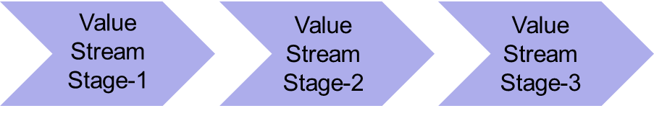




Zero-based Design: End-to-End Framework
Strategies
Investments
Op. Value Streams
Capabilities
Projects
Operational Value Stream
Enterprise Portfolio Alignment
Development Value Stream
Business Outcome
Empathy Gate
Produce
Enables
Value Gate
n:n
Are Ideas for Delivering
Iteration may surface requirement for new
Business Strategies & Initiatives
“Ability Statements” (ideas / needs)
Require
Capability
Decomposes into multiple
Features
Elaborated as
Story
Implemented via
ART/PI
Aids in identification of / Aligns with
Produces
Ideation Scope Types:
Business Strategy
Customer Exp.
Value Stream
Product Planning
Digital Transformation
Process Optimization
Etc.
Contains
May be described by
Epic
Decomposes into multiple
Working Software
Considerations:
What should happen first: Capability-level needs/blueprints, or Epics? How do they relate?
Do we manage Value at the Capability, Epic, Feature or “product” level, or a combination of them?
What are Delivery “Products”? What should we be life-cycle managing as “Products”?
Are there too many Features across an enterprise to realistically manage them at the Value & the Enterprise Planning levels?
Are individual Features too ‘small’ and inconsequential (i.e., to the Business? to IT Management?)
Do Features & Solutions eventually become subsumed into the technology/process landscape?
Is the concept of a Solution too vague and varied to utilize when becoming Product-centric?
Can we manage Features and Solutions as Products during SDLC execution, but not prior to or after that? (i.e., we use Capabilities for that)
Solution
Delivers

Slide 44
Ideation to Delivery
Ideas Needs Blueprints Requirements Solutions
Business Architecture
Drives definition of target-state
Is elaborated through
Scope
Types:
Future-State Ideation Workshops
Agile Features → Stories
Strategic Initiatives
Value Stream
Customer Exp.
Product Planning
Process Optimization
Etc.
Solution Architecture
Frames / Controls
Inputs to
Solutions
Maps to
Enterprise Technology Architecture
Frames / Controls
Complies to
Architecture
Portfolio Management and Alignment Mechanisms

Slide 45
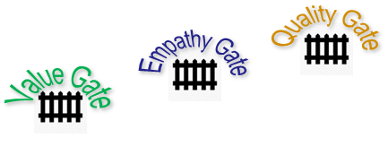

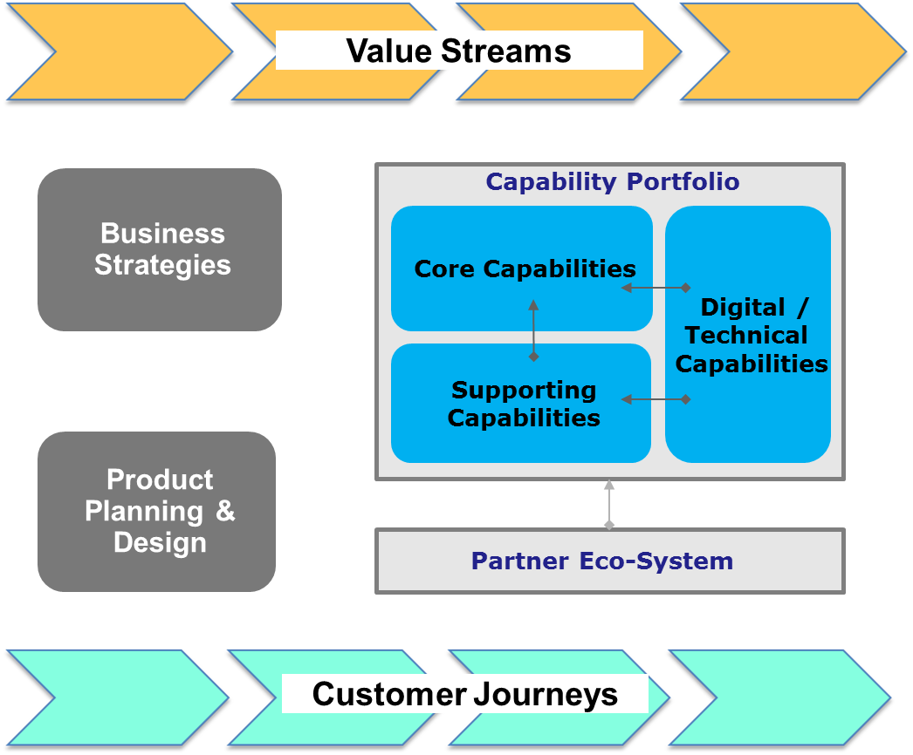
Ideation to Delivery
Ideas Needs Blueprints Requirements Solutions
Deliverables – i.e.,
- Domain Definitions
- Domain Model (w/ Bounded
Contexts, Ubiquitous Language)
- Domain-Capability Context Map
- Capability Target-State Models
- Customer Journey Models
- Value Stream Models
- Value/Outcome Map
- BizArch X-Mappings (various)
- Etc.
Business Architecture
Iteration
Scope
Types:
Future-State Ideation Workshops
Agile Features → Stories
Strategic Initiatives
Value Stream
Customer Exp.
Product Planning
Process Optimization
Etc.
Solution Architecture
Solutions
Deliverables – i.e.,
- Component Interaction
- Logical Architecture
- Data Model
- Services Model & Definitions
- Capability Alignment Map
- Feature Alignment Map
- Etc.
Deliverables – i.e.,
- Principles
- Standards & Policies
- Patterns
- Vetted Technologies
- Best Practices
- Frameworks
- Reference Models
- Etc.
Enterprise Technology Architecture
Architecture
Portfolio Management and Alignment Mechanisms

Slide 46
Translating Capability Requirements to Agile
4
Iteration Alignment
1
Capability-level Requirements
(“Ability Statements”)
2
Alignment Step
(new, or improvements to) (1:N or N:1)
3
Feature
Elaboration
Abstraction Level
“Ability to rapidly develop products by leveraging partner collaborations”
Feature
Theme
Epic
Epic
Feature
“Ability to provide Price Transparency to Customers”
Feature
Epic
Capability Portfolio
Feature
“Ability to set up a Family (vs. Individual) Subscription”
Feature

Slide 47
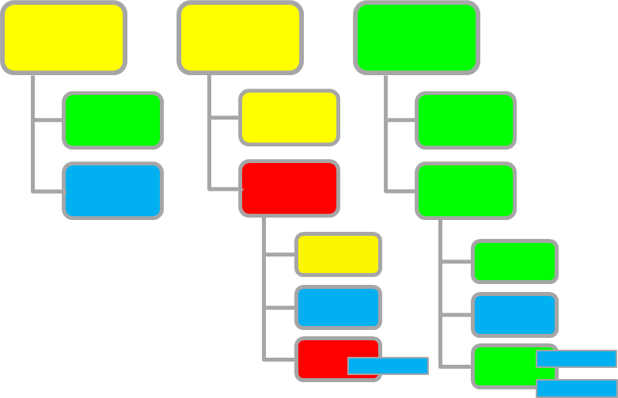
“Features and Capabilities are central to the SAFe Requirements Model. They are critical to defining, planning, and implementing Solution value.”
Customer
Journey
Step-1
Customer
Journey
Step-2
Customer
Journey
Step-3
Feature
Feature
Feature
Solution-1
Solution-2
New Capabilities and Capability Increments are implemented by 1 or more Features
Feature
Feature
Feature
Feature
Each Feature is delivered by one Agile Release Train in a Program Increment
Feature
Feature
Requirement Type
Feature
Feature
Features can originate from either the local context of the ART or they may result from splitting Epics or Capabilities.
Feature
= New Capability
= Capability Increment

Slide 48
Topics
Ideating and Delivering the Best Future: Opportunities and Challenges
Integrated Playbooks: Combining Design Thinking, Agile & Business Architecture Disciplines
Implementing a Product vs. Project-centric Approach
Design Thinking Workshop Kit
Scaling Agile: Vertical and Horizontal Considerations
Embedding Capabilities and Design Thinking approaches into key Functions & Processes

Slide 49
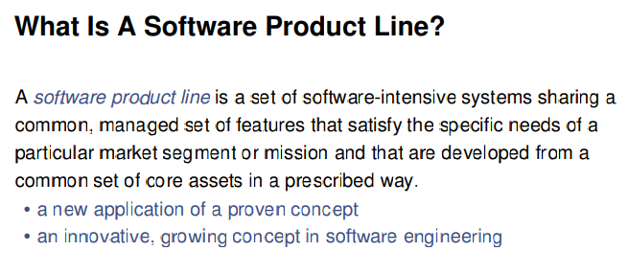
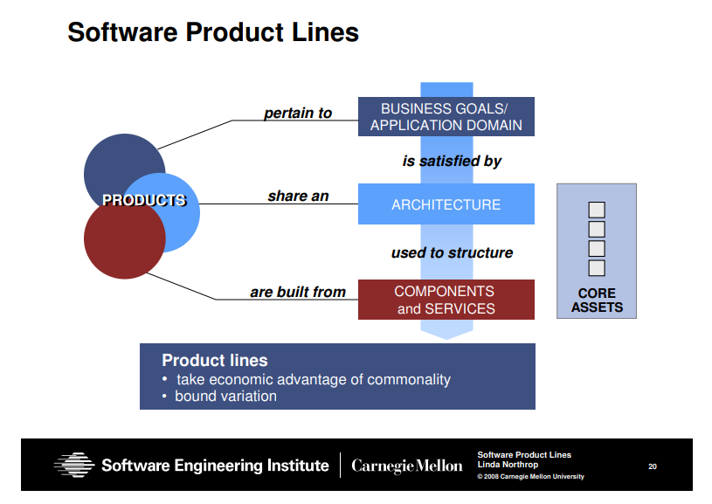
Products: Things we sell to customers? Or, internally-consumed “assets” (Agile)?

Slide 50
Product-centric Approach: Questions we need to answer
Definition: What do we mean by “Products”?
Candidates: What are some potential candidates for being managed as Products?
Life-cycle Management: What’s involved in life-cycle managing these Products?
Value: What value is derived from using a Product-centric approach?
Risks/Challenges: What adoption risks & challenges are we likely to face?
Meta Model: What does the underpinning planning & design Meta Model look like?
Agile / BizArch: How do Agile & Business Architecture fit with the Product approach?
Organization: What does the organizational support model look like?
Governance: What does the governance model look like?
Adoption: How do we design and implement a Product-based Approach?
Characteristics of Products:
Provide value
Encapsulate Capability
Clear scope and boundary
Multiple consumers
Are life-cycled managed
  Owner
  Product Manager
  KPIs
  SLAs
  Roadmap
  Change Management
  Etc.

Slide 51
Product-centric Approach: Questions we need to answer
Definition: What do we mean by “Products”?
Candidates: What are some potential candidates for being managed as Products?
Life-cycle Management: What’s involved in life-cycle managing these Products?
Value: What value is derived from using a Product-centric approach?
Risks/Challenges: What adoption risks & challenges are we likely to face?
Meta Model: What does the underpinning planning & design Meta Model look like?
Agile / BizArch: How do Agile & Business Architecture fit with the Product approach?
Organization: What does the organizational support model look like?
Governance: What does the governance model look like?
Adoption: How do we design and implement a Product-based Approach?
Value of a “Product” Approach:
Focus is on Business Outcomes vs. Technology or Project Delivery
We think more holistically about what we’re creating
We’re more empathetic to the Customers of our Product
We ensure that we consider the Life-cycle Management aspects that a Product demands

Slide 52
Product vs. Project-centric Approach
Candidates: What are some potential candidates for being managed as Products?
Applications
Vendor Tools
ITSM Services
APIs/(Micro)Services
Containerized Code
Data
Capabilities
Agile Constructs:
  Features
  Products
  Solutions
Commonplace
Commonplace
Commonplace
Commonplace

Slide 53
CX-centric Meta Model [example]
Produces / Impacts
Strategy
Means to Achieve
Business Outcome
P
Business Service
Measures
Drives
KPI / Measure
Product
Supports execution of
Contributes to
Impacts
Plan
P
Delivers on / Enables
Project
Has
Customer Experience
Program
Interactions
Produces
Improved by
Capability Increment
Funds & Delivers improvement in
Has
P
Customer Journey
Enables
Capability
Enables
Feature
Occurs in 1 or more
Physically realized by one or more
Executable Code
Process
Operational
Value
Stream
Capability
Instantiation
P
People
Technology
P
P
Information
Composed of
Information
Services
/ APIs
Are Agile “Products” & “Solutions” too varied & ephemeral and enveloped / subsumed by larger, more permanent Constructs (and Product-managed during the Development Value Stream only)?
P
Solution
P
P

Slide 54
Topics
Ideating and Delivering the Best Future: Opportunities and Challenges
Integrated Playbooks: Combining Design Thinking, Agile & Business Architecture Disciplines
Implementing a Product vs. Project-centric Approach
Design Thinking Workshop Kit
Scaling Agile: Vertical and Horizontal Considerations
Embedding Capabilities and Design Thinking approaches into key Functions & Processes

Slide 55
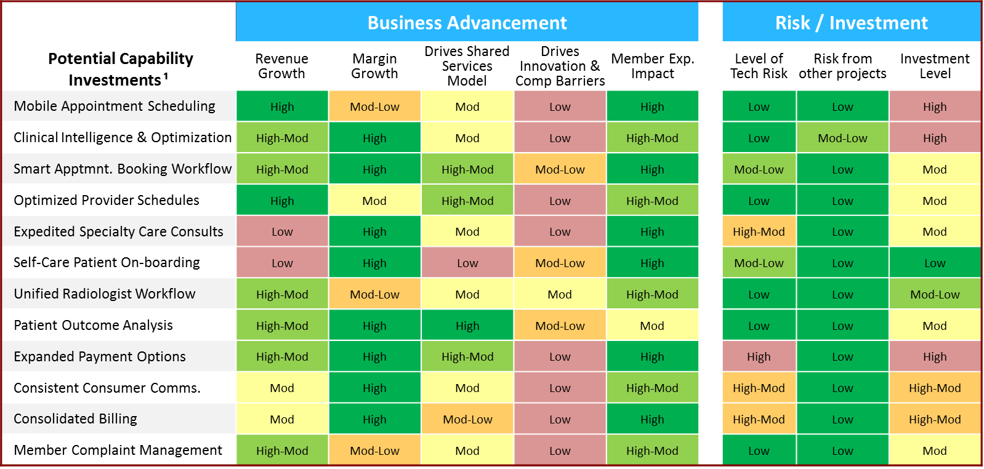

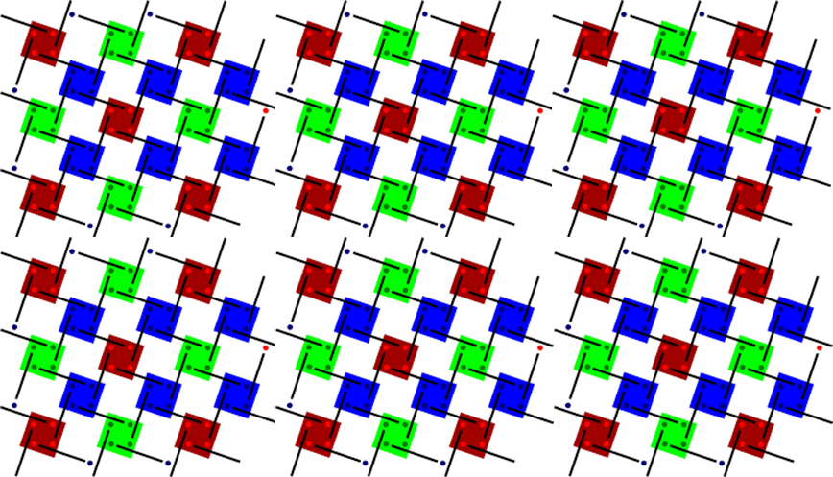
Integrated Approach for Enterprise Digital Transformation
Embedded Design Thinking Approach
Design Thinking Workshops provide a high-value “front door” to Enterprise Capabilities-based Planning (DT workshops produce Capability-level requirements)
LoB and Function
Needs & Opportunities
X-Cutting Disciplines & Programs
Value Chains & Customer Journeys
Integrated Planning, Innovation & Design
Capability Roadmaps
Shared Services
Performance Improvement
Enterprise Capability Portfolio
Investments
Products
Digital Health
Capabilities
Technology
APIs / Technology
Projects
The Business Architecture
Value / ROI?
Synergy?
Enables
Dependencies?
Competitive Advantage?
Platform Build-out?
Capability Value
Vendor & Industry Partnerships
Innovation?
= High
API / Microservices Fabric
Customer Experience?
= Medium
Consolidation?
Risk?
= Low
Roadmap Execution Enriches the API Fabric and Capability Portfolio
= ZBD Ideation Workshops (Design Thinking)

Slide 56
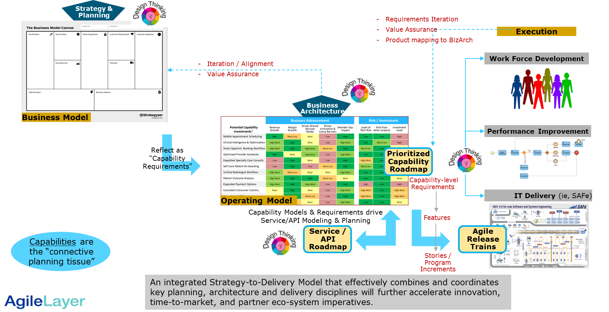
Driving Value through better End-to-End Alignment

Slide 57
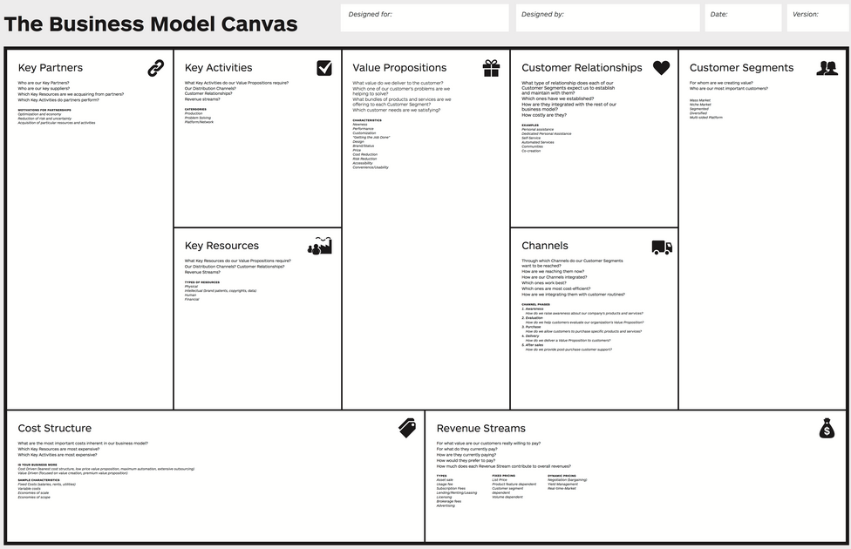

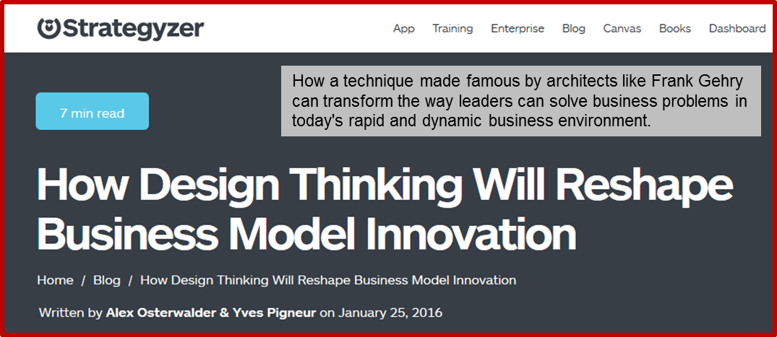
Design Thinking and Business Model Innovation
North Stars
2024: Global Coverage; 50% Franchise; 2% Churn
Facilitator Prompts
What if Channel Conflict was eliminated?
What if we co-funded Franchise set up?
What if our Competitors went to a Franchise-only model?
What about Sales Comp.?
Which adjacent industries could open up opportunity?
How can we scale faster?
Channels
Future State
“Ability Statements”
Empathy Drivers & Signals:
Frictionless Processes
Easy to Learn & Use Tools
“Five 9s” Support Experience
Providing Value-Adding Information
Etc.
Channels
“We need the Ability to provide Channel Partners with a fully automated On-boarding process.”
….

Slide 58
Integrated Design & Planning Framework
Value-centricity
Transparency
Alignment
Efficiency
Consistency
Best Practice
Strategy
Programs
Componentization
Componentization
Capabilities
Execution / Delivery
Operation
APIs & Services
Products
Products
CX
CX
Design Thinking
Value Targeting
Value Leak Detection
Value Assurance Analysis
Value Course Correction
Value Assurance Framework
Business Outcomes / Goals Management

Slide 59

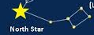


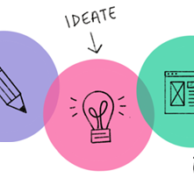
Zero-based Design to Delivery (“ZBD²”) Framework
North Stars, i.e.,:
De facto industry standard for ____
The World’s most convenient ____
Top 1 or 2 performer in all categories
Global footprint by 2023
Five 9s Quality
Constraint-Free Ideation, i.e.,:
Funding / Resource
Brand
Legacy Products / Businesses
Culture
Organizational Structure
Skills
Governance Model
Politics
IT
Systems / Technology
Business Processes
Aspirational
Constraint-free
Empathetic
Signs of Good Empathy:
Extremely Easy to Use
Does things I’d not thought of
Has great Support
Trivial Learning Curve
Provides us with options for growth
Fits seamlessly into how we work
Playbook Supported
Formal Prep Process
Skilled Facilitators
Targeted Ideation Domains
Drill-down via Ideation Lenses
Contextual Ideation Prompts
All Personae represented
Mindfulness Techniques
Evocative Ideation Prompts
A “No Wrongs” mindset
Focus & Structure
Free Form
Generates
“Ability Statements”
Capabilities-based
Planning
Solution
Prototypes

Slide 60
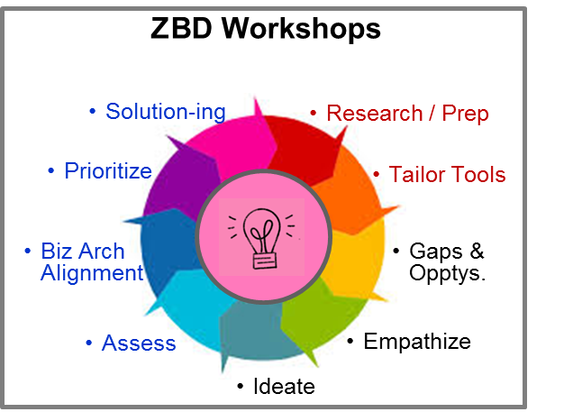
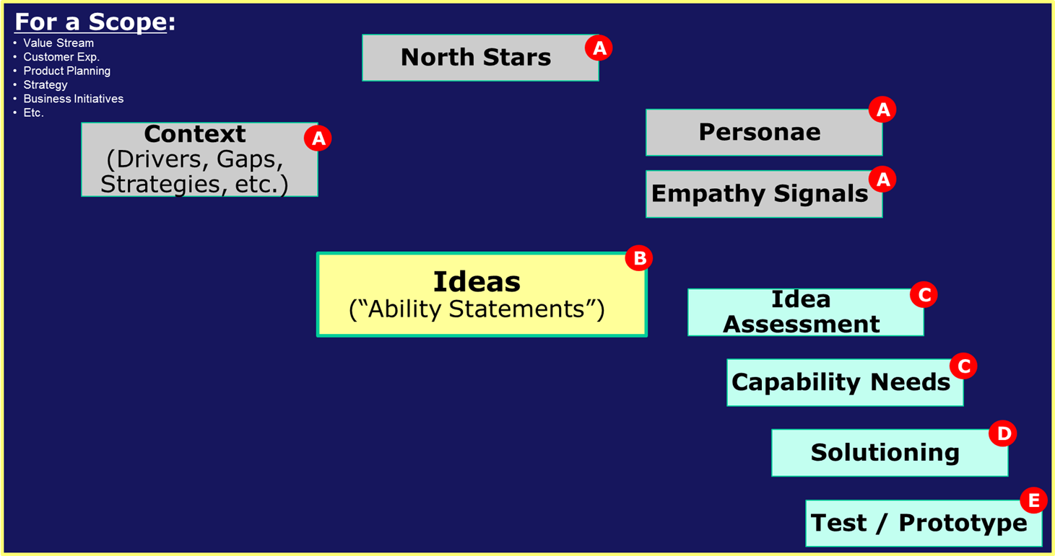
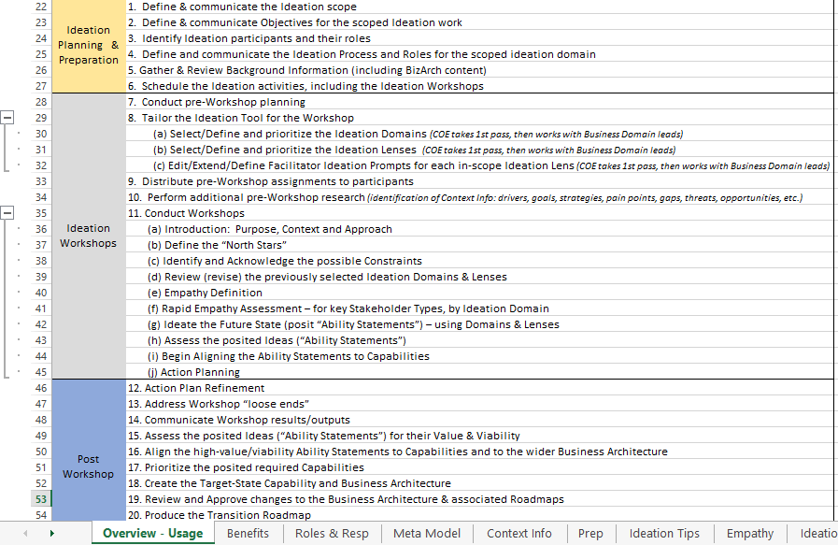
Zero-based Design: Ideation Workshop Approach
Pre-Workshop:
Define and Communicate Workshop Purpose, Scope and Audience
Gather & Review Background Information (including BizArch content)
Identify & Prioritize the Ideation Domains to be used (select from list)
Select & Prioritize the Ideation Lenses to be used (for each Ideation Domain)
Review and Revise (as needed) the Workshop Facilitator Prompts for each Lens
In-Workshop:
Introduction: Purpose, Context and Approach
Define the “North Stars”
Identify and Acknowledge the possible Constraints
Review (revise) the previously selected Ideation Domains & Lenses
Empathy Definition and Personae Identification
Rapid Empathy Assessment – for key Stakeholder Personae, by Ideation Domain
Ideate the Future State (posit “Ability Statements”) – using Domains & Lenses
Assess the posited Ideas (“Ability Statements”)
Begin Aligning the Ability Statements to Capabilities
Action Planning
Post Workshop:
Action Plan Refinement
Address any Workshop “loose ends”
Assess the posited Ideas (“Ability Statements”) for their Value & Viability
Align Ability Statements to Capabilities and to the wider Business Architecture
Prioritize the posited required Capabilities
Create the Target-State Capability and Business Architecture
Produce the Transition Roadmap
Communicate / Refine / Approve

Slide 61


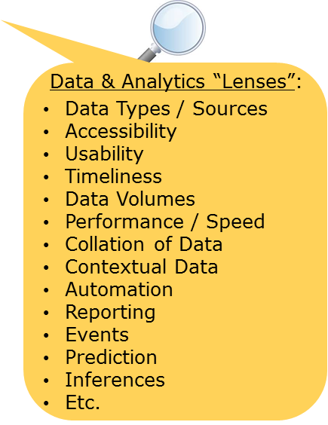
Ideation Domains – Framing & Focusing our Work
Client Experience
User Experience
Data & Analytics Features & Functions
Process Improvement
Technology / Integration
Non-Functional Needs
Ideation Domains:
Product
Channels
Customer Experience
Mobility
Social Computing
Internet of Things
People /Org.
Process Improvement
Technology
Integration
Data & Analytics
Artificial Intelligence
Partner Eco-Systems
Platform Development
Facilitation Prompts for the Data Types & Sources lens:
What Data "gaps" have been posited? Why do we think the gaps are accurate? What are our assumptions? Are they correct? How do we know?
Are we leveraging all potential Data Types & Sources: i.e., Customer, Competitor, Market, Financial, Operations, Product, Channel, Partner, Employee
Which Data Types & Sources are most critical to us? Why?
Do we have, or can we obtain, the rights to the critical Data? Can we get exclusive rights? How?
What dependencies or inhibitors are their with respect to securing targeted Data Sources? Can we uniquely overcome them? How?

Slide 62
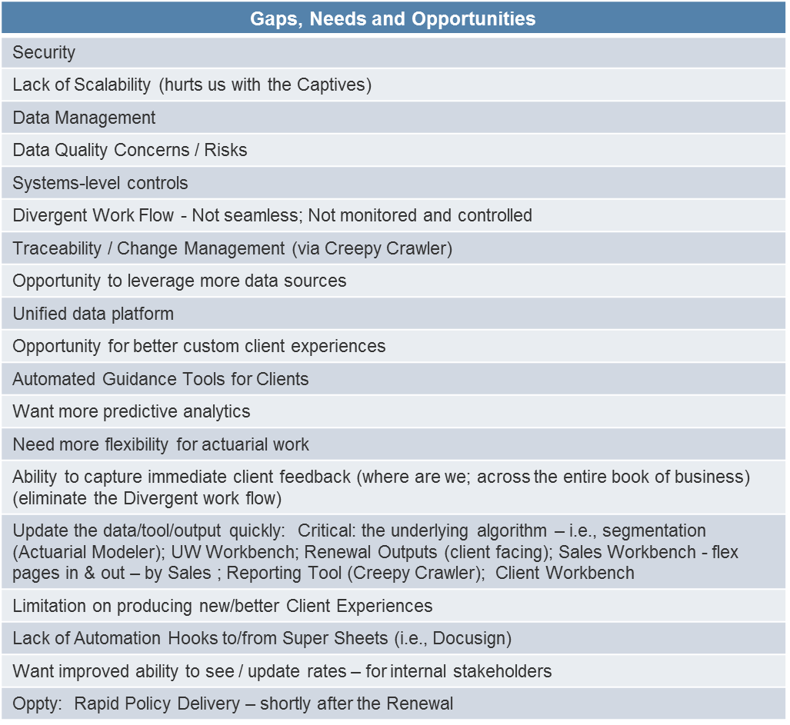

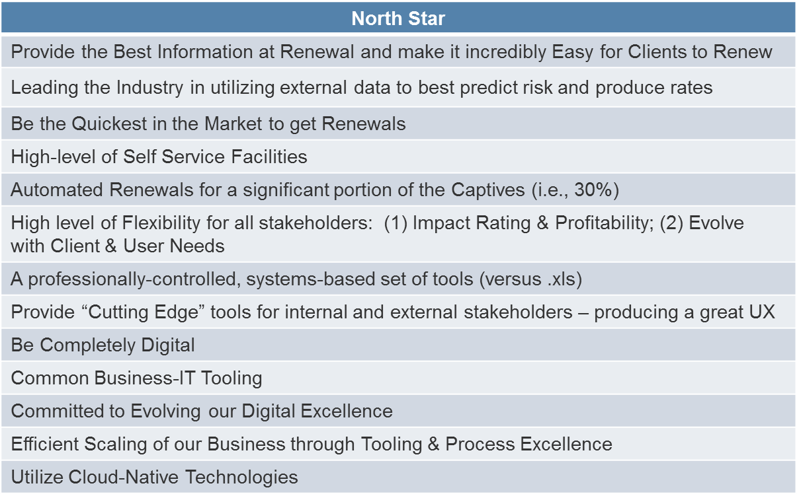

“Ability Statements” – Client Experience
Client Experience (ideation domain)
1. Ability to deliver more of an integrated, data-rich experience for our clients
2. Ability to electronically receive, sign and return renewals
3. Ability to communicate more easily and directly with us during the process – providing a streamlined process
4. Ability to provide client’s with a supported and guided process
5. Ability to provide a Portal of Information and Tools accessible to the Clients
6. Ability to provide a Unique and Differentiated CX (through specialized and unique Tools and Services)
7. Ability to provide a tailored CX via Client (Segment) Profile (i.e., Personalized Content – via Push and Pull facilities)
8. Ability for Clients to obtain On-line Quotes
9. Ability to provide (internal) Competitor Rates more quickly – and possibly provide Quick Quote Rates
10. Ability to promote the value our products during the client experience
11. Ability to provide a completely digital experience
12. Ability to provide an integrated workflow experience (via better Administrator integration) – 1-stop Self Funded CX
13. Ability to capture immediate client feedback
Signs of Good Empathy:
Extremely Easy to Use
Does things I’d not thought of
Has great Support
Trivial Learning Curve
Provides us with options for growth
Fits seamlessly into how we work
Client Experience “Lenses”:
Information Rich
Value-Added Insights
Client Responsiveness
Line-of-Sight
Reporting
Etc.

Slide 63






Assessing the Ability Statements: Client Experience
5=High, 1-Low

Slide 64


Ideating Potential Solutions
Downstream Business Impact Analysis

Slide 65

Zero-based Design: End-to-End Framework
Value Stream
CX
Product Planning
Business Initiatives
Etc.
Design Thinking Steps
Work Scope Types:
Empathy Gate
Value Gate
Value-centered Iteration
“Ability Statements”
Capabilities
(aka BizArch)
Solution Descriptions
Agile Features / Stories
Solution
Prototypes
Imposes Good Architecture
Enterprise Alignment
Program Increments
Solution Arch.
Prioritization
Roadmap
Roadmap
Empathy Gate
Empathy Gate
Empathy Gate
Empathy Gate

Slide 66
Topics
Ideating and Delivering the Best Future: Opportunities and Challenges
Integrated Playbooks: Combining Design Thinking, Agile & Business Architecture Disciplines
Implementing a Product vs. Project-centric Approach
Design Thinking Workshop Kit
Scaling Agile: Vertical and Horizontal Considerations
Embedding Capabilities and Design Thinking approaches into key Functions & Processes

Slide 67
The Scaled Agile Imperative: An Opportunity
Scaling Agile fuels the adoption and exploitation of Business Architecture and Capabilities-based Planning
Agile can be tightly coupled to Design Thinking, with great effect
Is a key enabler of a Next-Gen Business-IT Collaboration Model
Move us to a flexible & continual planning, design & delivery model
Fosters support for a “Product” (and Value) vs Project approach

Slide 68
The Scaled Agile Imperative: An Opportunity
How do we actually do this at our company?!...
How do we effectively scale Agile to the Enterprise?
How do we ensure that the Committed-To-Value is realized?
How do we ensure adherence to Design Thinking principles?
How do we successfully combine Architecture and Agile?
How do we create a Common Planning Language and Approach?
What type & level of Gating Mechanisms should we implement?
How do we create grass roots buy-in and momentum?
How do we pilot & roll-out an integrated Enterprise approach?

Slide 69
The Scaled Agile Imperative: An Opportunity
Will My Delivery Be Slowed Down?!
The Get:
The Ask:
Identify & leverage existing Capabilities
Quicker / Better Dependency Analysis
Awareness of opportunities to collaborate with other areas to deliver better Solutions faster
Accessible and Useful Guidance on how to design and build things (via Reference Architectures & Implementations, Patterns, Standards, etc.)
Build towards a Digital Fabric that can be extended & exploited by all business areas
Better / Wider Use of Design Thinking
Accelerated Delivery
Use the provided standards, patterns, etc.
Drive Agile Requirements definition from Business Architecture (Capabilities)-based Roadmaps
Review Gates that include Empathy and Capabilities/Biz. Architecture elements
Systematically identify new/additional ideas, synergies, dependencies through a wider exploration of what’s happening elsewhere (using the provided Business Architecture-based knowledge stores and supporting collaboration mechanisms)

Slide 70
The Scaled Agile Imperative: An Opportunity
Integrated, Scaled Enterprise Planning & Delivery Approach
Value Assurance
Opportunity Leverage
Scaled correctly, Agile can also give us this!:
Vertical Scaling
Dependency Management
Sophistication / Value Add
Architectural Fit
Why we really did this: Faster IT delivery (and the corollary: Increased IT capacity)
Agile Delivery Processes
and Practices
Horizontal Scaling
Scaled Adoption

Slide 71
The Scaled Agile Imperative: An Opportunity
Integrated, Scaled Enterprise Planning & Delivery Approach
Key Functions
Value Assurance
X-Cutting Disciplines
5
ePMO
Opportunity Leverage
CX
The Key Supporting Elements
4
Business Arch/EA
Capability Portfolio & Roadmap
Design Thinking
Solutions Arch.
Enterprise Arch
Dependency Management
3
DDD
Delivery
Architectural Fit
Process & Perf. Improvement
2
Phased Roll-out / Adoption Program
Scrum to Enterprise-level Usage Continuum
Voluntary vs. Governed Activity (phased)
Integrated Guild & CoE Support Model
Product (Capability) vs. Project Approach
Explicit Meta Model/Data and Governance
Agile Delivery Processes
and Practices
= Maturation Sequence
1

