Slide 1
Keep your business & life running smoothly in an emergency
November 4, 2021
MACC 2021: Surviving The Crisis:
What Changed and What Didn't?

Slide 2
MACC Overview
The Midwest Architecture Community Collaboration’s (MACC) purpose is to bring all domains of architecture together to share information and techniques of interest to all of us. It is our shared belief that through collaboration, we can better understand and promote the significance of architecture to business success.

Slide 3
Keep your business & life running smoothly in an emergency
Key Takeaways:
How to identify your second-in-command
The must-have contingency plan strategy for your business and your life
Three steps to take this week to better prepare for the unexpected.
© 2021 Niche Partnership Consulting LLC®. All Rights Reserved.

Slide 4
Tell us in the chat
Who handles the finances in your world?
For your business
For your personal life
NichePartnershipConsulting.net

Slide 5
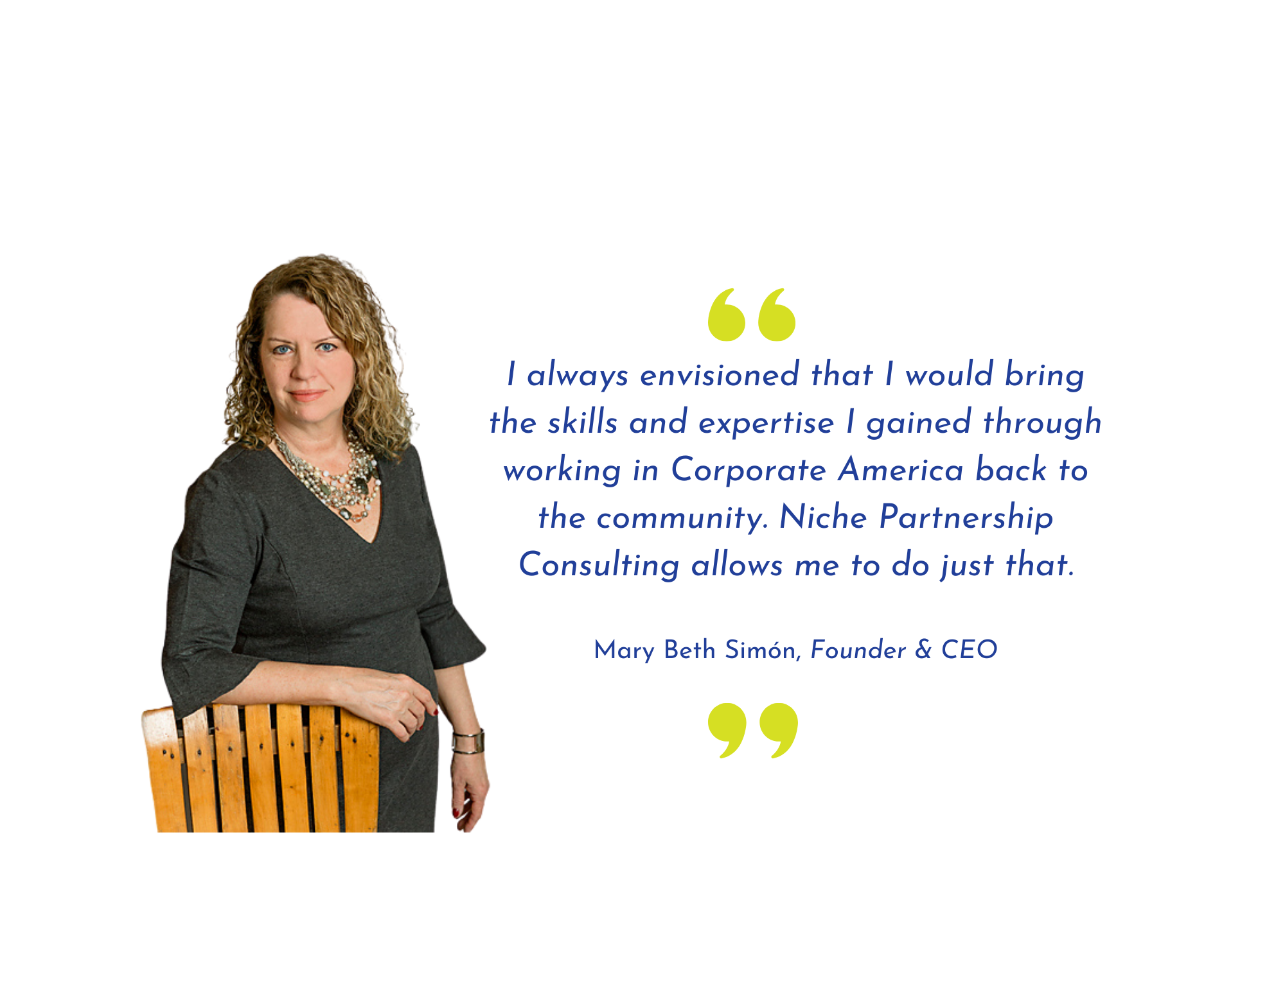
NichePartnershipConsulting.net

Slide 6
NichePartnershipConsulting.net

Slide 7
Keep your business & life running smoothly in an emergency
NichePartnershipConsulting.net

Slide 8
Three Reasons to Stay Until the End
1. Learn what qualities you need in your second-in-command.
NOBODY TALKS ABOUT THIS!
2. Get answers to your individual questions.
3. How to get started today with your free Contingency Plan Kit.
NichePartnershipConsulting.net

Slide 9
Notes:
Poll Title: Do not modify the notes in this section to avoid tampering with the Poll Everywhere activity. More info at polleverywhere.com/support What one word describes how not having your contingency plan in place for your business and personal life yet will impact those closest to you? https://www.polleverywhere.com/free_text_polls/BZyhnfPfA9AEtpK5fBR6j

Slide 10
Having a plan in place helps you manage the day-to-day as well as an emergency
NichePartnershipConsulting.net

Slide 11
What we'll be covering
1. How to identify and empower your second-in-command to keep business and life running smoothly in your absence.
2. Learn the contingency plan frameworks for your personal life and business.
3. Understand what’s in a business continuance playbook for business owners.
4. How to get started.
NichePartnershipConsulting.net

Slide 12
Strategy #1
How to identify and empower your second-in-command to keep business and life running smoothly in your absence.
NichePartnershipConsulting.net

Slide 13
We buy into the fact that we need to back-up our data & systems.
But who do we train to step in for us in our absence?
NichePartnershipConsulting.net

Slide 14
When people are unprepared to pick up where we left off,
it creates stress, struggle and sadness.
NichePartnershipConsulting.net

Slide 15
To be a successful second-in-command, your appointee needs to possess these qualities . . .
NichePartnershipConsulting.net

Slide 16
Think Outside The Box
Is that person . . .
Your business partner or significant other?
Your adult child or another family member?
Your friend?
A colleague in a professional organization?
Your bookkeeper or accountant?
Your . . .
NichePartnershipConsulting.net

Slide 17
After you create your contingency plan,
schedule time to train your second-in-command.
If you don't train your second-in-
command how to implement your plan, then the problem is only partially solved.
NichePartnershipConsulting.net

Slide 18
Strategy #2
Follow the AWARE
framework to create your contingency plan for your personal life and your business
NichePartnershipConsulting.net

Slide 19
AWARE FRAMEWORK
Assemble Important Documents
Review Annually with Your 2nd in Command
Easy Password System Is Essential
Accept Your Mortality. Create Legal Documents
Who Do You Trust to Be Your 2nd in Command?
First – Personal
Second - Business
NichePartnershipConsulting.net

Slide 20
A = Accept Your Mortality
NichePartnershipConsulting.net

Slide 21
W = Who do you trust?
NichePartnershipConsulting.net

Slide 22
A (For Your Personal Life) = Assemble important documents
Bank Accounts
Beneficiaries
Birth Certificate
Cable/Internet
Card Photos
Collections
Credit Cards
Divorce Decree
Final arrangements
Health Insurance
Investments
Life Insurance
Long-term Care Insurance
Living Will/Healthcare Directive/Medical PoA
Marriage Certificate
Medical History
Phone/Mobile
Power of Attorney
Real Estate
Rental Properties
RMD
Social Media
Social Security
Utilities
Vehicles
Will
NichePartnershipConsulting.net

Slide 23
A (For Your Business) = Assemble important documents
Bank Accounts
Business Owner Insurance
Cable/Internet
Company Vehicles
Contracts
Credit Cards
Devices & Hardware
Health Insurance Administration
Incorporation Documents
Intellectual Property
Investment Properties
IT Assets
Liability Insurance
Loan Documents
Memberships
Payroll
Post Office Box
Real Estate
Rental Properties
Social Media
Subscriptions
Taxes: State, Federal
Tax ID
Utilities
Volunteer Organizations & Roles
Website
NichePartnershipConsulting.net

Slide 24
R = Review with your second-in-command at least annually or more frequently if needed.
NichePartnershipConsulting.net

Slide 25
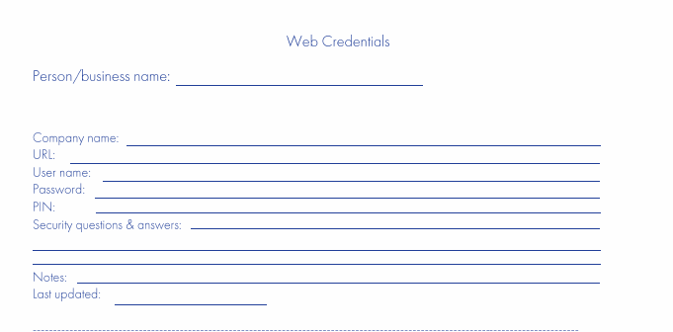
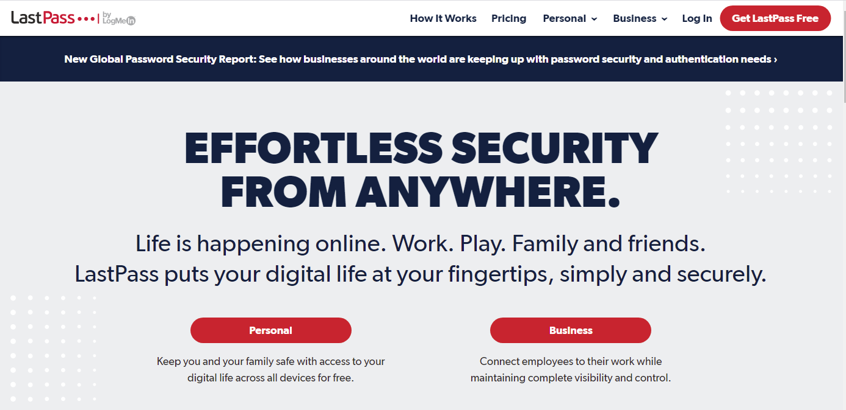
E = Easy password system
NichePartnershipConsulting.net

Slide 26
Strategy #3
Use the COPE
framework to create your business continuance playbook
NichePartnershipConsulting.net

Slide 27
COPE Framework
Procedures & Decisions Documented
Evaluate with Key Personnel & Keep Current
Capture Owner R&R at 30-60-90 Day Intervals
Owner Operating Procedure Inventory
NichePartnershipConsulting.net

Slide 28
Strategy #4
Three Steps You Can Take This Week to Better Prepare for the Unexpected
NichePartnershipConsulting.net

Slide 29
Step #1
Make an appointment with your attorney
NichePartnershipConsulting.net

Slide 30
Notes:
Poll Title: Do not modify the notes in this section to avoid tampering with the Poll Everywhere activity. More info at polleverywhere.com/support What percentage of Americans have their estate planning documents in order? https://www.polleverywhere.com/multiple_choice_polls/GxneR8zNUu7vV8wOBAhJC?flow=Default&onscreen=persist

Slide 31
Americans and Estate Planning Documents
In 2017, almost half (42%) of all Americans said that they have a will or another type of estate planning document.
Fast-forward to 2020, and less than one-third (32%) say they have one or more documents – that's a decrease of nearly 25% in just three years.
Source: 2020 Estate Planning and Wills Study - Caring.com
NichePartnershipConsulting.net

Slide 32
Step #2
Identify your second-in-command
NichePartnershipConsulting.net

Slide 33
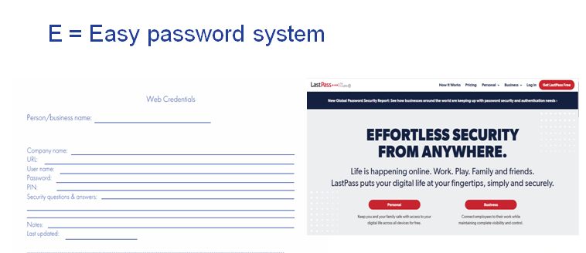
Step #3
Document your passwords.
Ask anyone you're responsible for to do the same.
NichePartnershipConsulting.net

Slide 34
Get Your Free Contingency Plan Kit at https://nichepartnershipconsulting.net/macc
NichePartnershipConsulting.net

