Slide 1
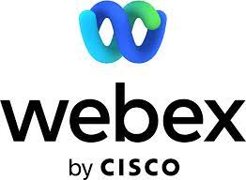
UCaaS Security & Privacy
Sorell Slaymaker
Principal Consulting Analyst

Slide 2
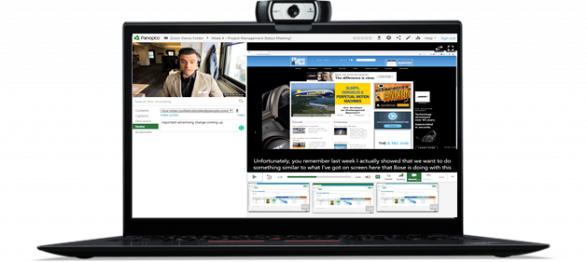
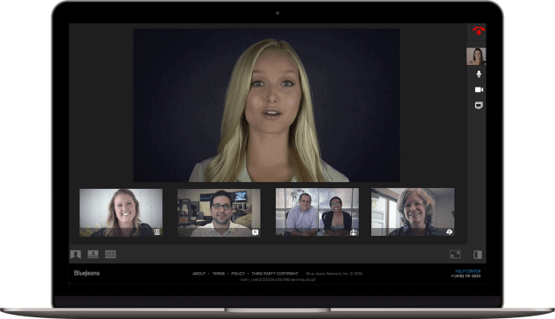
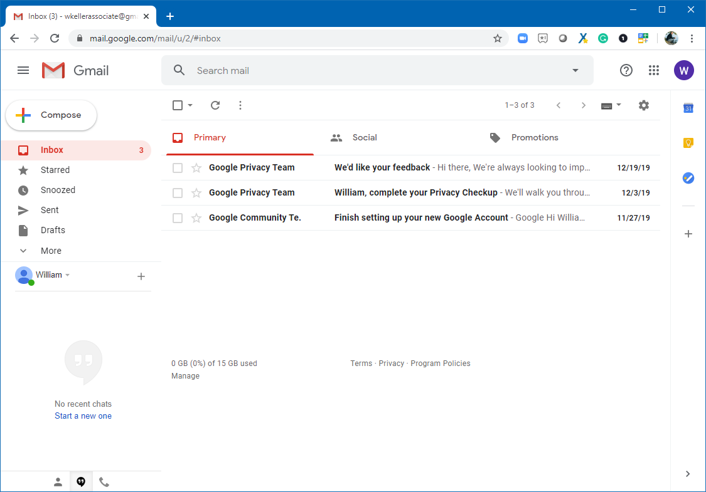
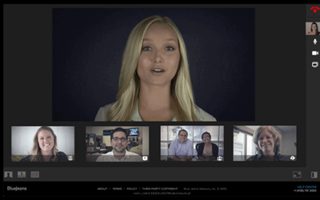
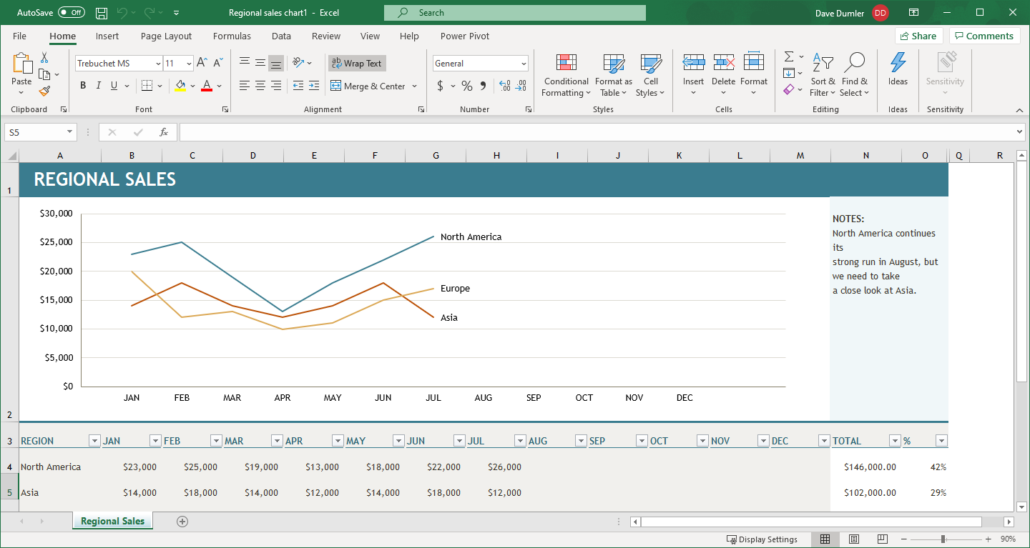
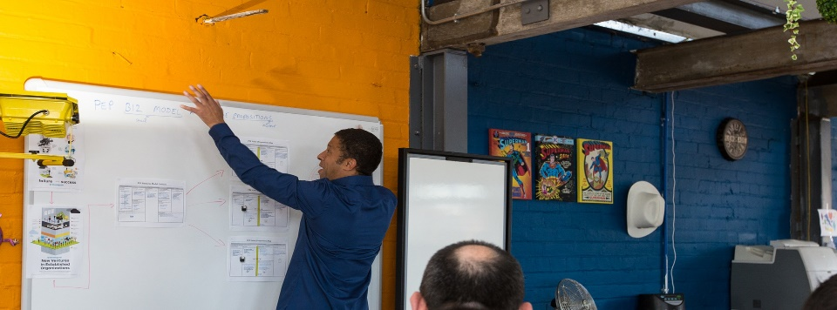
Communication Security & Privacy Is Evolving
Documents
Email
UCaaS
Most enterprises have strict guidelines around document and email management but lack the same type of security and privacy controls for cloud based real-time Communications platforms
2

Slide 3
Why UCaaS Security & Privacy Now?
There are over 50M meetings every business day in the U.S. alone
75% of these meetings (up from 25% 2 years ago) now occur using cloud-based video conferencing with greater adoption driven by convenience, lower costs, and Covid-19.
40% of meetings are being recorded, up from 10% 2 years ago and storage of recordings can be local, cloud such as Box, or UCaaS
Transcription of meetings is becoming common including translation services which makes searching for content quick and easy
Regulations and best practices specific to UCaaS are new and evolving including data residency and retention within specific countries.
Meeting content can be shared and does not have the controls or retention, redaction, and deletion that emails and documents have
3

Slide 4
How Much Of What You Are Sharing Is Worth?
Information that impacts earnings
Intellectual property
Sales leads
Contracts
Cost of buying and selling
HR info
Personal information
4

Slide 5
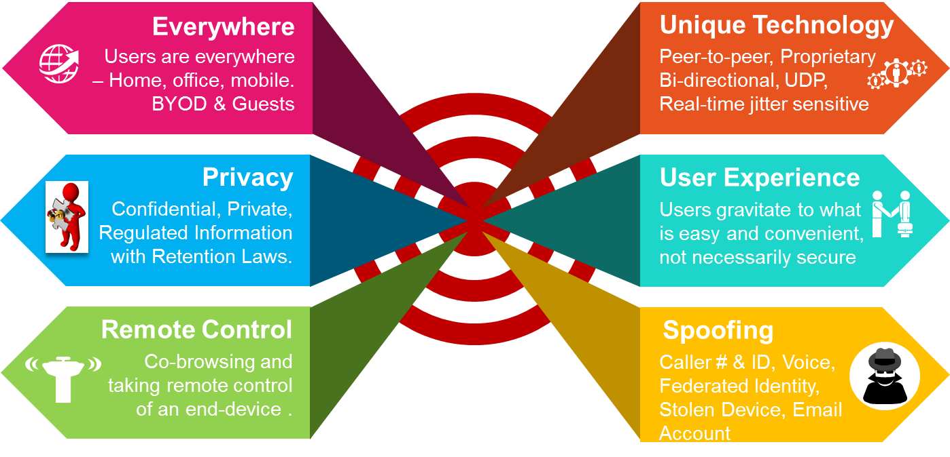
UCaaS Security & Privacy Is Challenging
5

Slide 6
Balancing Convenience, Security, & Privacy
Convenience
Any Device – Personal or Managed
Any Where – Home, Office, Road
Easy – Single button to join
Intuitive – Simple UX
Privacy
Regulations -
Data Residency
Organizational Controls
User Controls
Convenience
Security
Privacy
Security
IAM – MFA incl. Biometrics
Encrypted – End-to-End
Location – Geo-fencing
DLP - Data Classification
Integrated
Consistent across all platforms
Automated using ML & AI
SSO Authentication
Retention policies
6

Slide 7
Complex Global Cloud Legal Environment
Explicit Regulation
Effective Regulation
Corporate Policy
Regulations that explicitly define data protection and localization requirements such as FZ-152 (Russia), GR71 (Indonesia), GDPR, HIPPA, PCI-DSS, SOC2, ISO 27001
Governments exercising control over data and data flows
Access for law enforcement
Civil rights
Regulations that are in draft or opaque such as China’s Cybersecurity and PDPL
Different rules in effect for multi-national corporations vs. local enterprise
Open to interpretation and not enough time for courts to issue rulings
Enterprises implementing corporate policies to protect or localize data
Address worker and/or trade union requirements
Proactive data privacy and data protection such as what Apple & Google do
7

Slide 8
Regulations Depend on Country & Data Type
Data Processing
Data Storage
Viewability
Processing must be performed within country for all data
Processing of de-identified data can be processed out of country
All data can be processed out of country if it is encrypted in transit and at rest
Only copy of data in country
24 hour copy of the data in a country
Integration with Key Management Service
All data can be store outside of country
Can only be viewed within the country’s borders
Can be view from outside the country
8

Slide 9
Data Residency Models
Data Handling | Replicated | Restricted | Redacted
Storage | Inside & Outside | Inside Only | Inside Only
Processing | Outside | Outside | Inside Only
Viewing | Inside & Outside | Inside & Outside | Inside Only
9

Slide 10
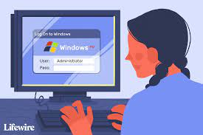
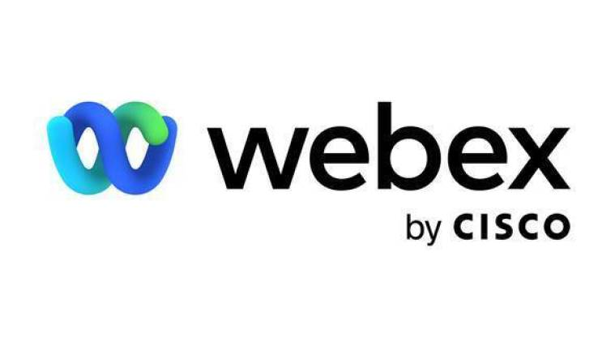
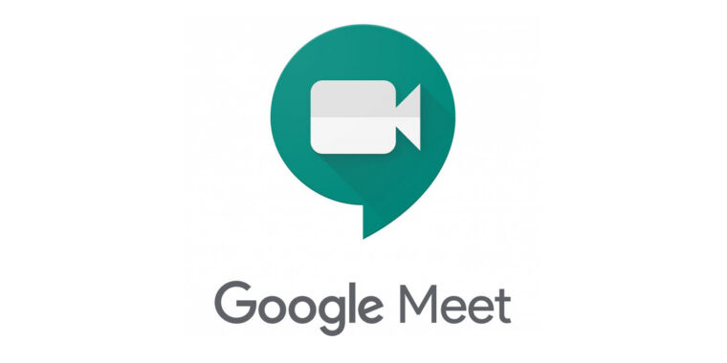
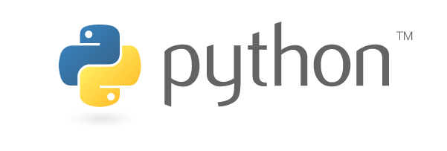
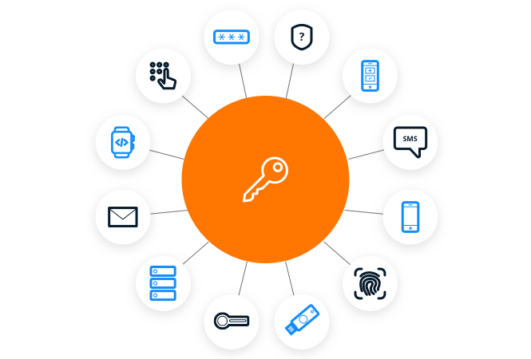
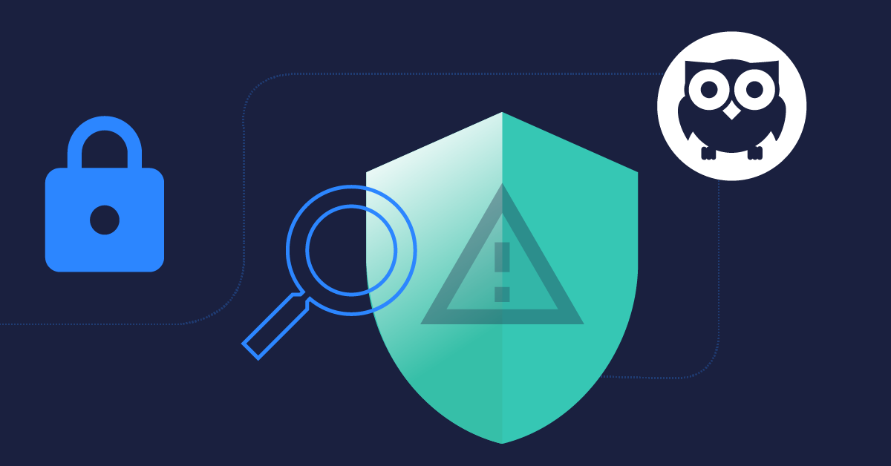
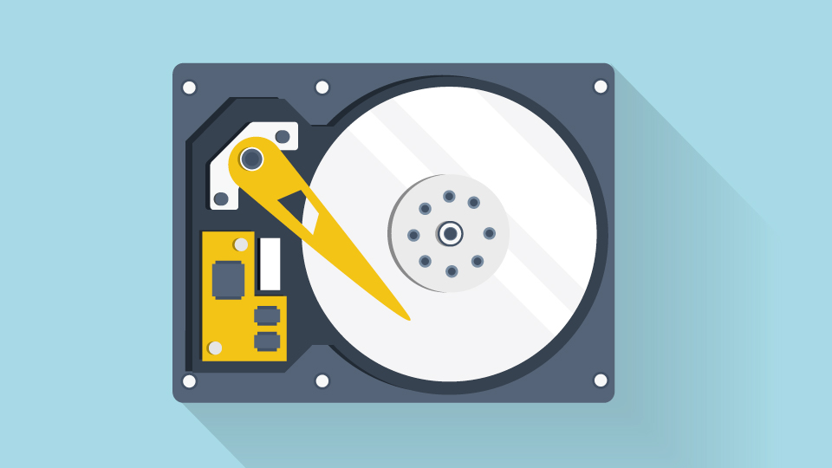
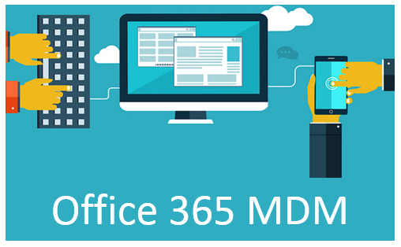
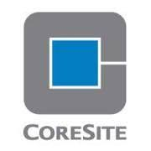
UCaaS Solution Stack
Users
Administrator
Host
Participants
Bots
UCaaS Applications
Communication Services
Video
Voice
Email/ Calendar
Chat
Web
Recording
Translation
API Integration
REST
SOAP
SDK
Data & Classification
Public
Confidential
Secret
Personal
Internal-Only
Restricted
Security
IAM
MFA
Encryption
SIEM
Zero Trust
Storage Vault
MDM
Infrastructure
On-
Prem
IaaS
Co-Lo
10

Slide 11
UCaaS Security & Privacy Use Cases
Protecting Intellectual Property: R&D team chats, files, and interactions are secured and controlled via strictly defined access rules including location such as R&D facility and manufacturing plant in foreign country
Ensuring Privileged Company Communications: CxO and Exec Management interactions regarding M&A deals, Investor relations, Sensitive HR comms, CxO status meeting
Providing Ultra-Secure Communications: In the event of a cyber-security breach or suspected attack, being able to communicate in a secure, out-of-band, trusted-circle or channel is critical so hackers cannot be part of your remediation actions
Securing Sensitive Customer Service Interactions: Some external customer and frontline communications need to be kept from going rogue under any circumstances due to potential brand and reputational damage implications
The Best Compliance: Manage GDPR cross-border PII data transfers without hassles, Comply with labor laws such as “right to be forgotten,” or “right to disconnect,” be able to offer CCPA protection to customers without skipping a beat, ability to provide compliance audits, HIPAA related communications, etc.
11

Slide 12
Communications Security & Privacy Framework
Identity | Network | Encrypt -ion | Device | Proxy | SIEM
MFA OTP, Time, Location | Zero Trust | Per Session/ Message BYOK | Locked Down | DLP CASB Water-marks | AI Anomalies Compliance Bots
Directory AAA | Private, VPN, MDM | End-to-End | Enterprise Managed | For each service | Required
User Provided | Any | Optional | Any | Basic | Optional
Ultra-Secure
(Military Grade)
Enterprise Grade
Consumer Grade
Characteristics for each Security Tier
Data Storage
Vault VCM
Cloud Box, UCaaS, Drive
On Device
12

Slide 13
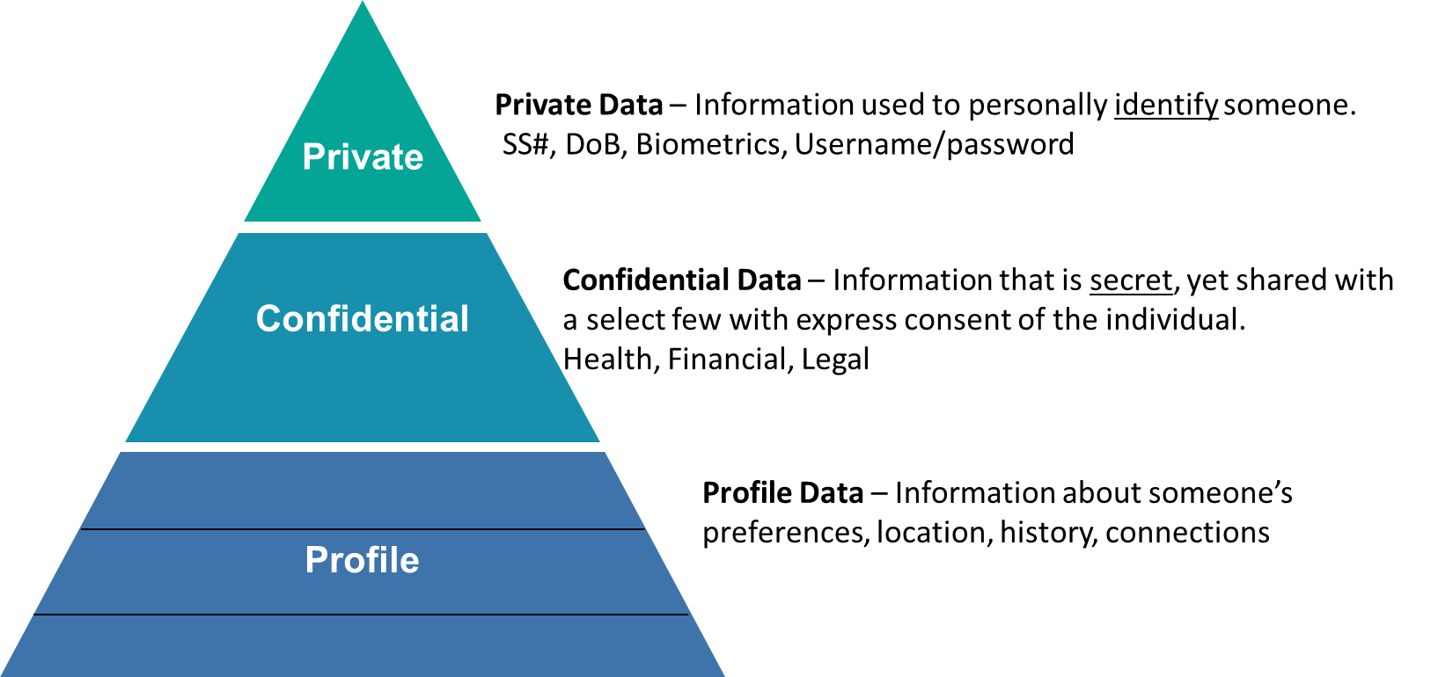
Understanding & Classifying User Data

Slide 14
Good Questions We Do Not Have Answers To….. Yet!
How much security and privacy is enough? – is there an end game?
Which conversations/interactions are private and why? Recording, Transcriptions makes things discoverable – Emails and documents are discoverable, when will meetings be and will this force all meetings to be recorded?
How do we protect employees from themselves? How do we ensure compliance, DLP, inappropriate behavior and/or language is not used?
14

Slide 15
Conclusions
More security and privacy is on its way as regulations and compliance is getting stricter and fines are going up
Many enterprises do not take communication security seriously even though many phishing and other attack vectors come through communications
New World, New Rules – Example - Enforcing company approved background for all video conferences
15

